Slide 1
UID & UCC Creation Process for TM and LPTM

Slide 2
Introduction
1. What is UID ?
Answer - UID stands for Unique IDentity Number. This is a 15-digit alpha numerical number. This UID number will be available with all the Trading Members and Limited Purpose Trading Members.
2. What is UCC ?
Answer - UCC stands for Unique Client Code. This is a 19-digit alpha numerical number. This will be required for bullion trading and Clearing & Settlement purposes.
Description | Number of Characters in UID
Client Type Symbol | First 3 characters
Client Type | Next 1 characters
Client Status symbol | Next 4 characters
Unique Running Number | Last 7 characters
 | Total 15 characters
Description | Number of Characters in UCC
Trading Member code | First 4 characters
Client Type Symbol | Next 3 characters
Client Type | Next 1 characters
Client Status symbol | Next 4 characters
Unique Running Number | Last 7 characters
 | Total 19 characters

Slide 3
Membership guide for creating UID
Combination | Client Type | Client Status | Client Category | PAN Number
1 | Individual | Client | RI-Resident Indian | Please enter respective countries regulatory document reference number.
2 | Individual | Client | NRI-Non Resident Indian | Please enter respective countries regulatory document reference number.
3 | Individual | Client | FPI-2-Foreign Portfolio Investor-2 | Please enter respective countries regulatory document reference number.
4 | Individual | Client | EFI-1-Eligible Foreign Investor-1 | Please enter respective countries regulatory document reference number.
5 | Non Individual | OWN | BCO-Body Corporates | Please enter respective countries regulatory document reference number.
6 | Non Individual | OWN | QJ-LP-Qualified jwellers-Limited Purpose Trading Member | Please enter respective countries regulatory document reference number.
7 | Non Individual | OWN | Qualified jwellers-TR | Please enter respective countries regulatory document reference number.
8 | Non Individual | OWN | TRQ | Please enter respective countries regulatory document reference number.
9 | Non Individual | OWN | QS-LP-Limited Purpose Trading Member | Please enter respective countries regulatory document reference number.
10 | Non Individual | Client | BCO-Body Corporates | Please enter respective countries regulatory document reference number.
11 | Non Individual | Client | FPI-2-Foreign Portfolio Investor-2 | Please enter respective countries regulatory document reference number.
12 | Non Individual | Client | EFI-1 Eligible Foreign Investor | Please enter respective countries regulatory document reference number.
13 | Non Individual | Client | QJ-Qualified Jwellers | Please enter respective countries regulatory document reference number.
14 | Non Individual | Client | NA-NOMINATED AGENCIES | Please enter respective countries regulatory document reference number.
15 | Non Individual | Client | Qualified jwellers-TR | Please enter respective countries regulatory document reference number.
16 | Non Individual | Client | TRQ | Please enter respective countries regulatory document reference number.
17 | Non Individual | Client | Qualified Supplier | Please enter respective countries regulatory document reference number.
18 | INSTITUTION | INSTITUTION | EFI-1-Eligible Foreign Investor-1 | Please enter respective countries regulatory document reference number.
19 | INSTITUTION | INSTITUTION | EFI-2-Eligible Foreign Investor-2 | Please enter respective countries regulatory document reference number.
20 | INSTITUTION | INSTITUTION | I-IBUs | Please enter respective countries regulatory document reference number.
21 | INSTITUTION | INSTITUTION | AF-AMCs & FUNDS | Please enter respective countries regulatory document reference number.
22 | INSTITUTION | INSTITUTION | FB-FOREIGN BANK | Please enter respective countries regulatory document reference number.
23 | INSTITUTION | INSTITUTION | NB-NOMINATED BANKS | Please enter respective countries regulatory document reference number.

Slide 4
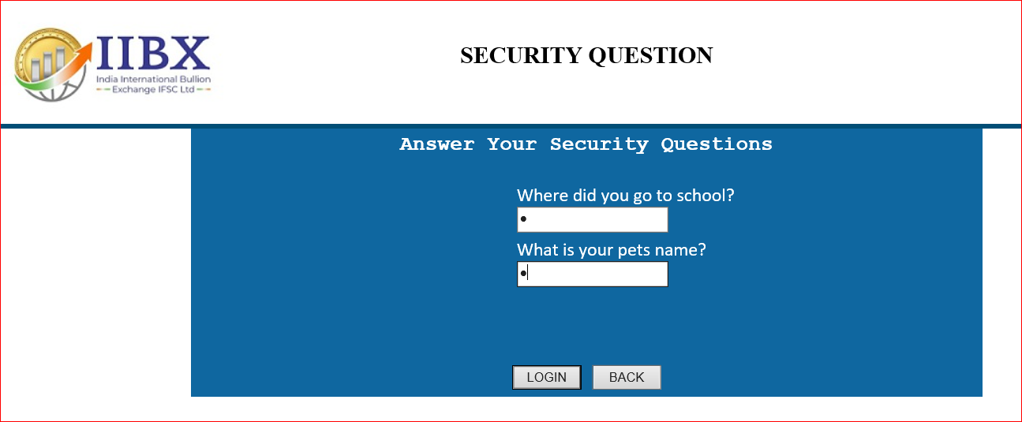
UID & UCC Creation Process for TM and LPTM
Step 1. Login in UCC portal - https://ucc.iibx.co.in. For User ID and Password details, kindly refer to the IIBX Login Credentials email sent to your registered email ID.
1
3
UID Creation
2

Slide 5
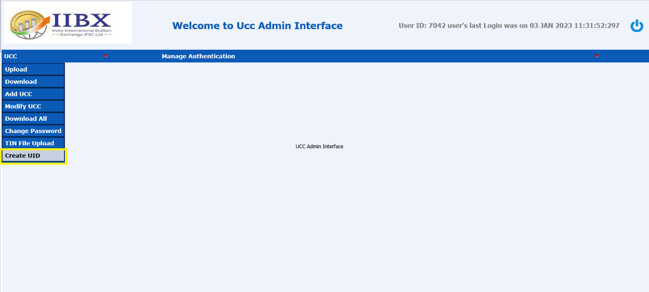
UID & UCC Creation Process for TM and LPTM
Step 2. Click on Create UID option in UCC Menu
UID Creation

Slide 6
UID & UCC Creation Process for TM and LPTM
Step 3. Fill appropriate details and click on Submit button.
UID Creation
Guide for selecting the Client Type, Client Status and Client Category is shared in earlier slides

Slide 7
UID & UCC Creation Process for TM and LPTM
Step 4. Click OK on the Below message that will display.
UID Creation

Slide 8
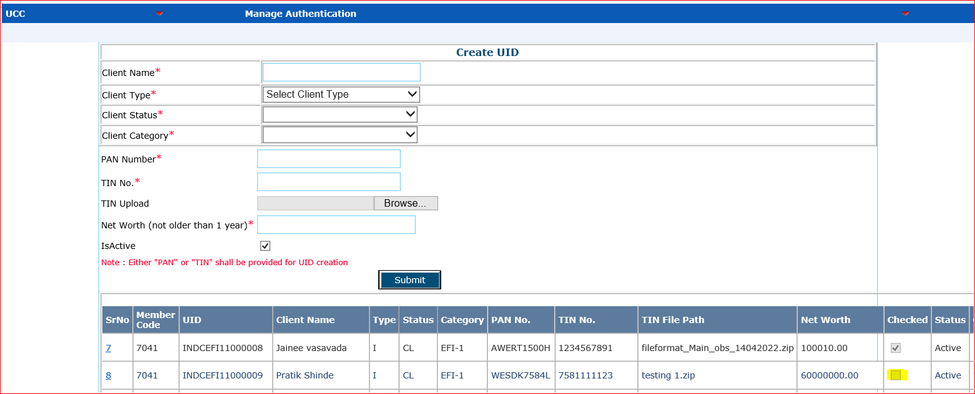
UID & UCC Creation Process for TM and LPTM
Step 5. After clicking OK button from the above display, your UID is Created successfully. You will be able to see the below display you can identify your UID number with Entity name or Entity PAN number which will be displayed in the below manner.
UID Creation

Slide 9
UID & UCC Creation Process for TM and LPTM
Step 6.
You are requested to kindly send an e-mail from your registered e-mail ID to membership@iibx.co.in with subject line to read as “UID approval – entity name”. Kindly mentioned client’s name, UID No. and attach a self-attested scan copy of PAN or TIN of the said entity with cc to trading.operations@iibx.co.in for authorizing the created UID
UID Creation

Slide 10
UID & UCC Creation Process for TM and LPTM
Step 7. Once the UID is authorized by IIBX officials, generated UID will be displayed with a tick on Checked column button. You can also identify the same with the Entity Name and Entity PAN No.
UID Creation

Slide 11
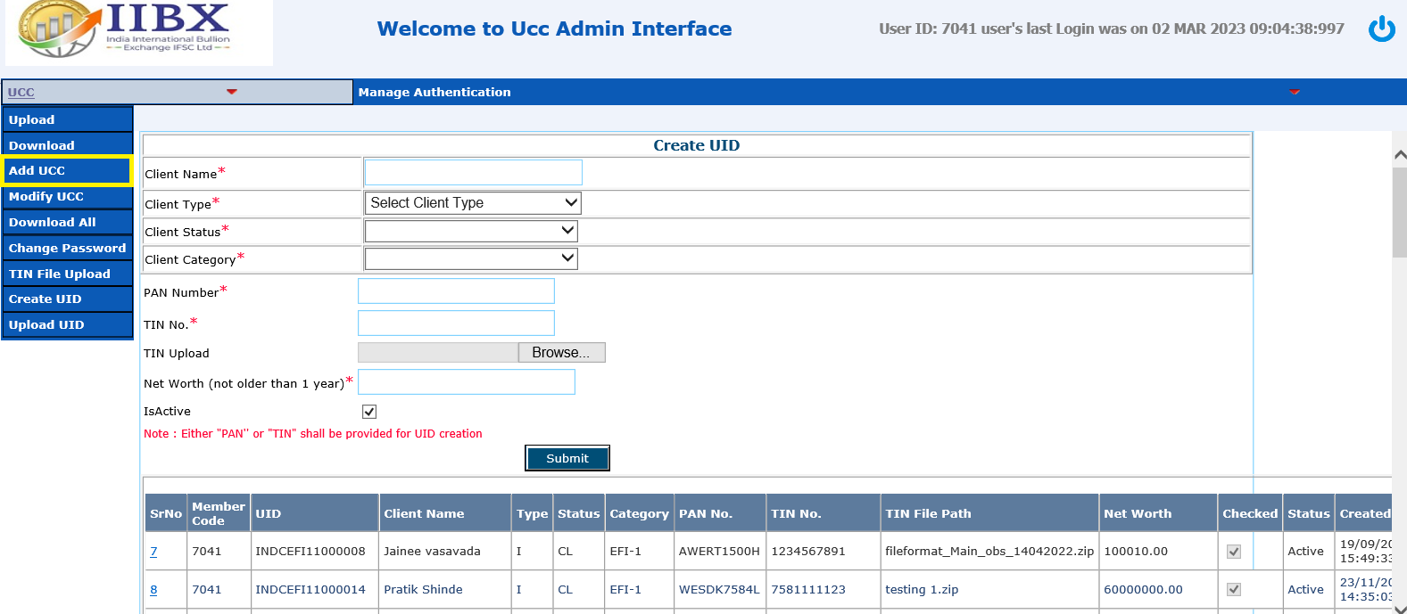
UID & UCC Creation Process for TM and LPTM
Step 8. Click on UCC >> Add UCC and below Menu will be displayed.
UCC Creation

Slide 12
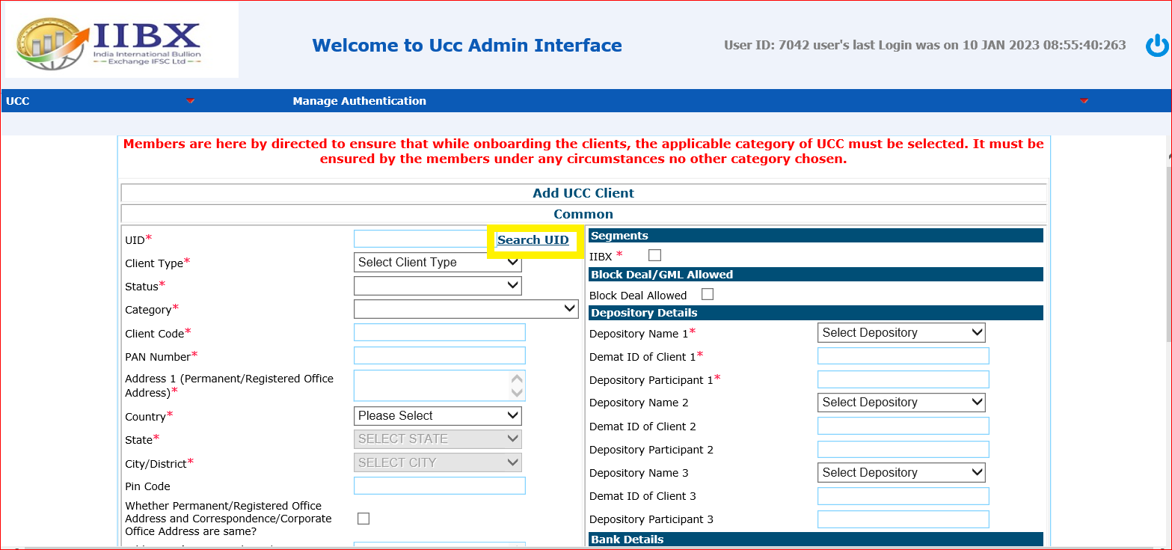
UID & UCC Creation Process for TM and LPTM
Step 9. Click on Search UID button.
UCC Creation

Slide 13
UID & UCC Creation Process for TM and LPTM
Step 10. Kindly write your UID (e.g., NIDOQSLP1000007) in the available field and click on GO Button.
UCC Creation

Slide 14
UID & UCC Creation Process for TM and LPTM
Step 11. Once you have selected the necessary UID, you will find respective details like UID, Client type, Status, Category, Client Code and PAN Number field which will be fetched automatically. Here your UCC will be generated automatically. Kindly make a note of the same for all future references.
UCC Creation

Slide 15
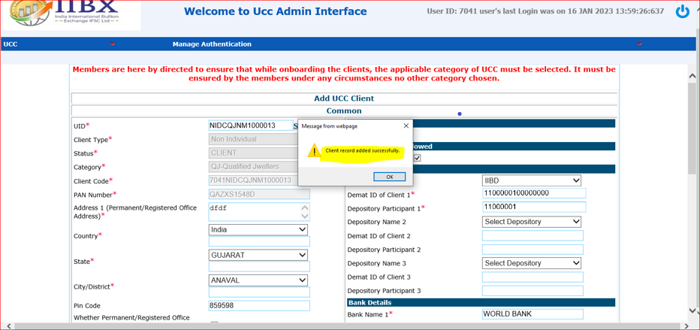
UID & UCC Creation Process for TM and LPTM
Step 12A. Request you to kindly fill all the remaining details and click on the Submit Button which is present at the bottom right corner of your screen. Required UCC will be created in the system.
Scenario 1 If the client is not registered with any broker of IIBX, below screen will be displayed.
UCC Creation
Demat ID must be 16 Digit
Depository Participant ID
must be 16 Digit

Slide 16
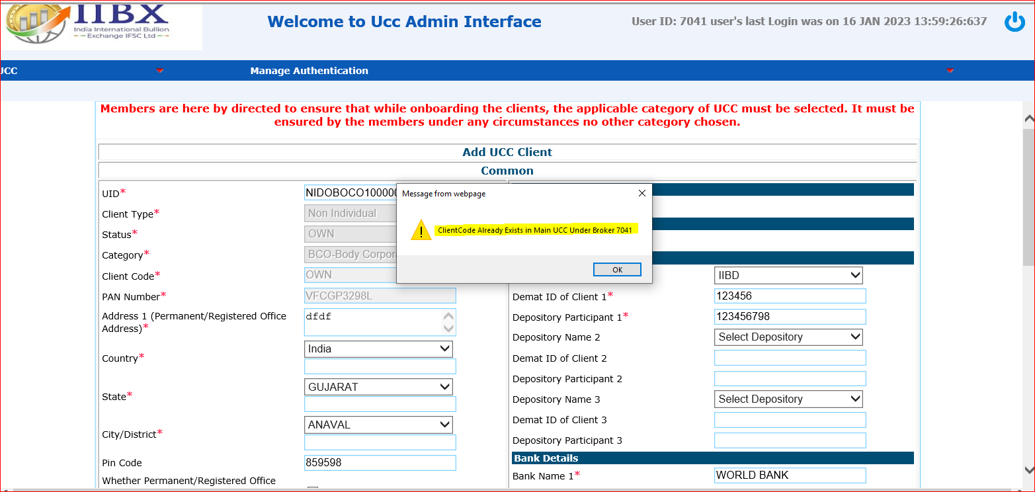
UID & UCC Creation Process for TM and LPTM
Step 12B. Request you to kindly fill all the remaining details and click on the Submit Button which is present at the bottom right corner of your screen. Required UCC will be created in the system.
Scenario 2 If the client is registered with any broker of IIBX, below screen will be displayed.
UCC Creation

Slide 17
Your UID and UCC has been created successfully

Slide 18
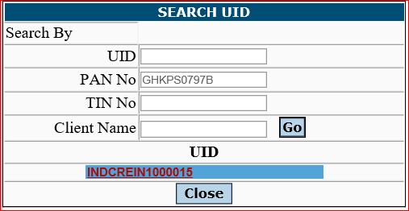
Frequently Asked Questions
1. If I forget to note my UID, how can I find it ?
Answer - Click on UCC >> Add UCC then Click on Search UID button.
Kindly insert your PAN and / or TIN and / or Client Name and click on Go Button.

Slide 19
Frequently Asked Questions
2. If I forget to note my UCC, how can I find it ?
Answer - If you want to find UCC first find UID (as per FAQ No.4)
19-digit UCC = 4-digit Trading Member Code + 15-digit UID
Example – 7041INDCREIN1000014

Slide 20
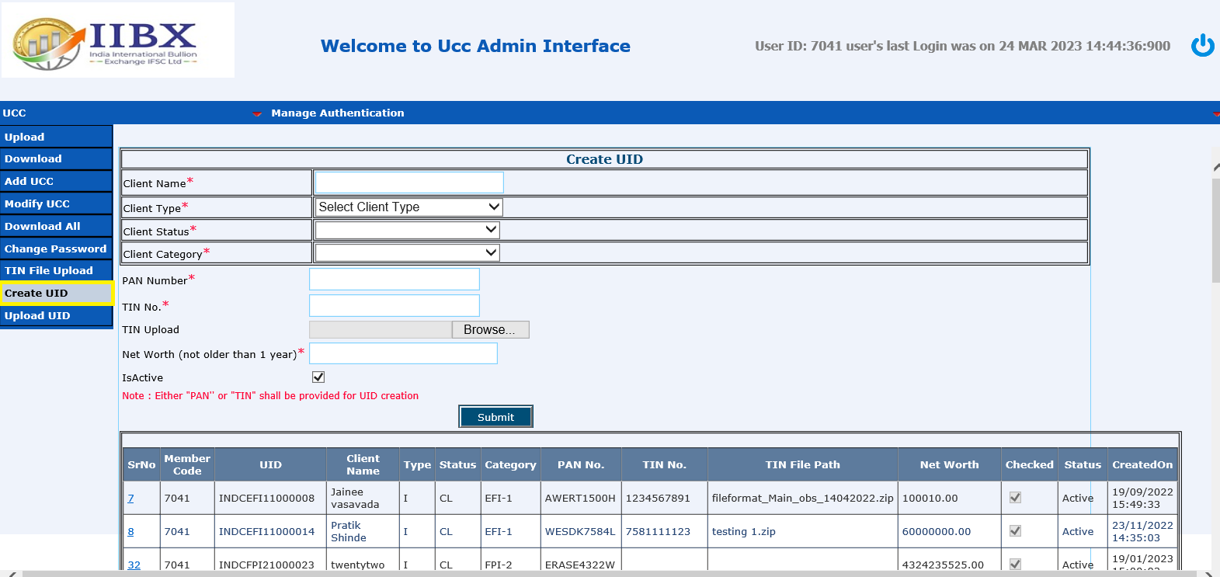
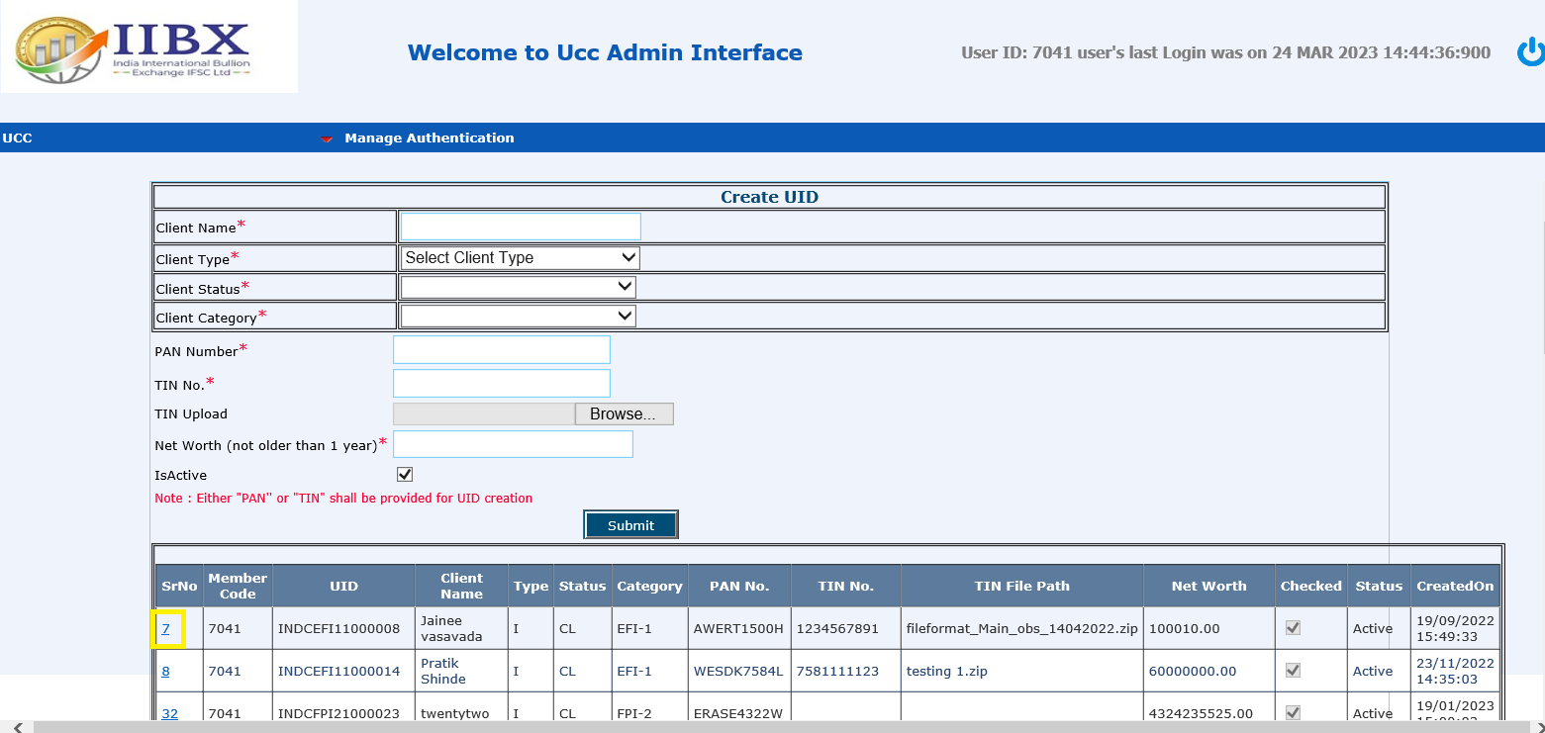
Frequently Asked Questions
3. How can I modify my Net Worth in UID?
Answer - Step – 1 of 4 - Click on Create UID
Step – 2 of 4 - Click on Sr. No. button of UID which needs to be modified.
Step - 1
Step - 2

Slide 21
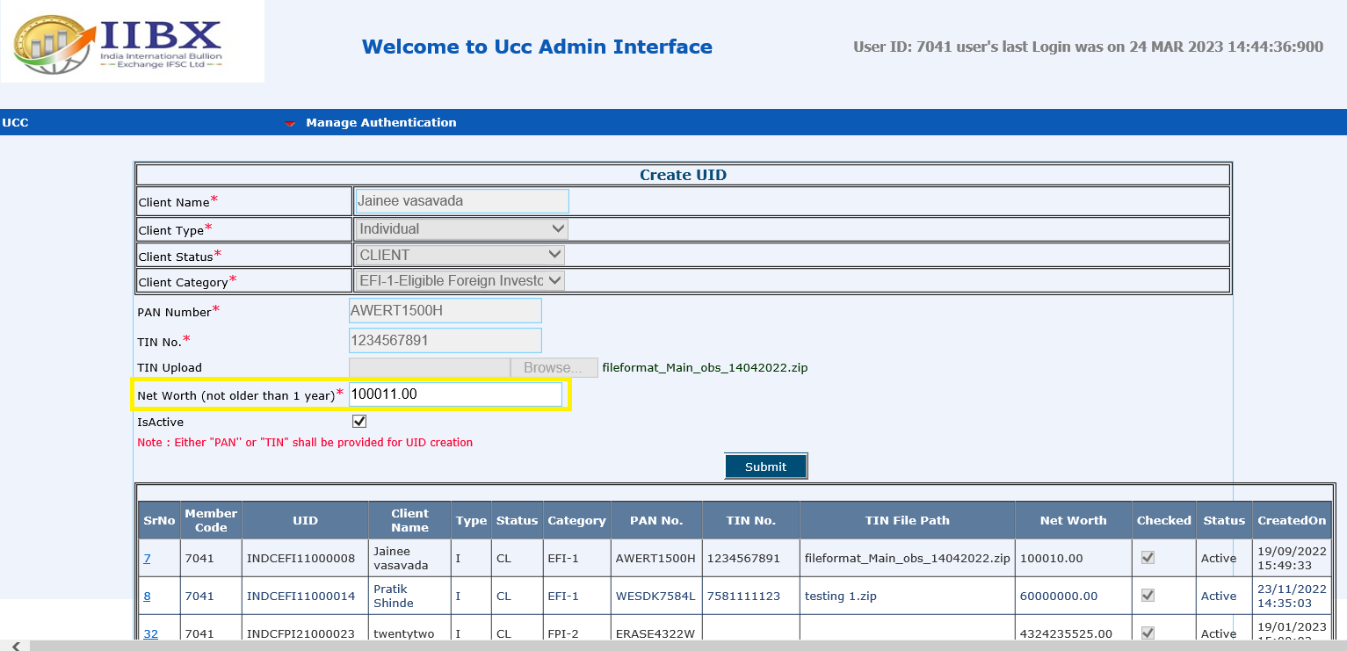
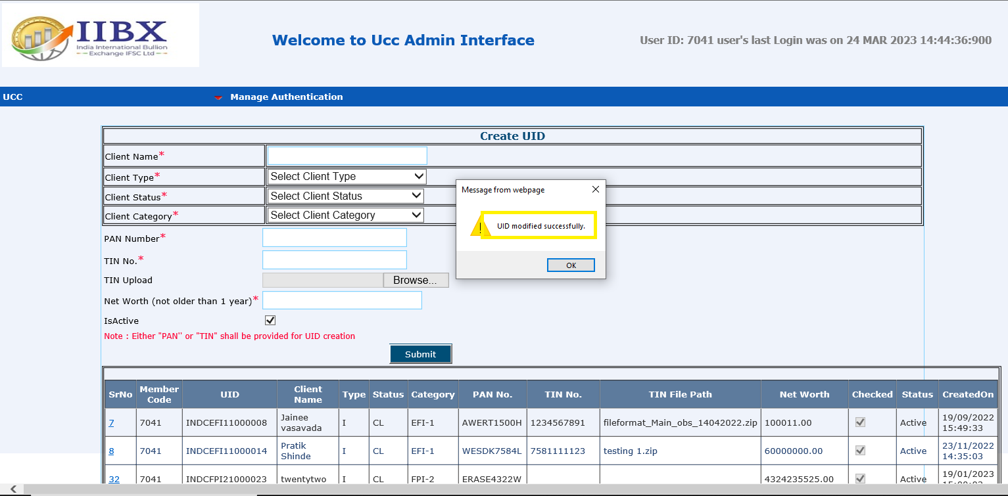
Frequently Asked Questions
3. How can I modify my net worth in UID?
Answer - Step – 3 of 4 - Net Worth menu modification label will get activated.
Step – 4 of 4 – Make necessary changes and click on Submit button.
“UID modify successfully” messages display on screen.
Step - 3
Step - 4

Slide 22
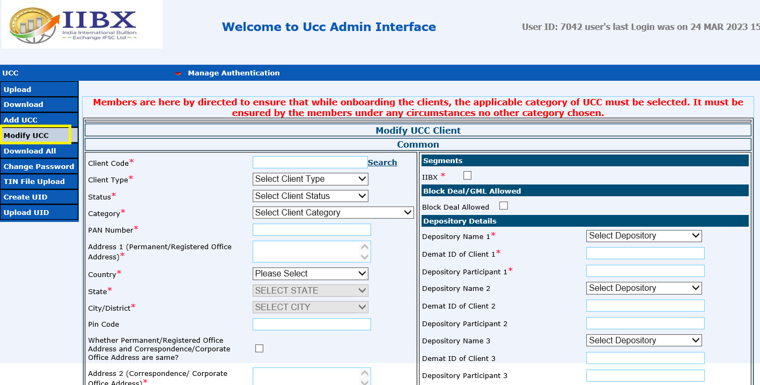
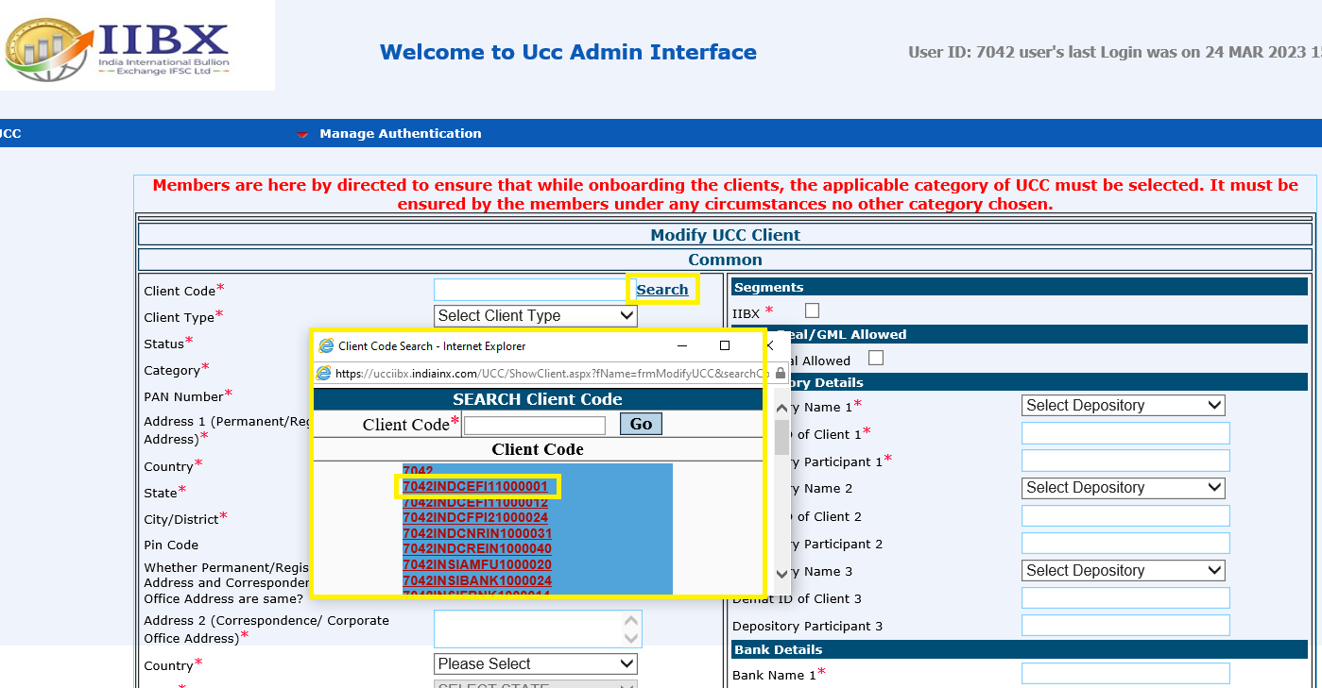
Frequently Asked Questions
4. How can I modify my details in the created UCC?
Answer - Step – 1 of 4 - Click on Modify UCC
Step – 2 of 4 - Click on Search button of UID >> Search Client Code, You can see all existing UCC list there. Select Client code which needs to be modified.
Step - 1
Step - 2

Slide 23
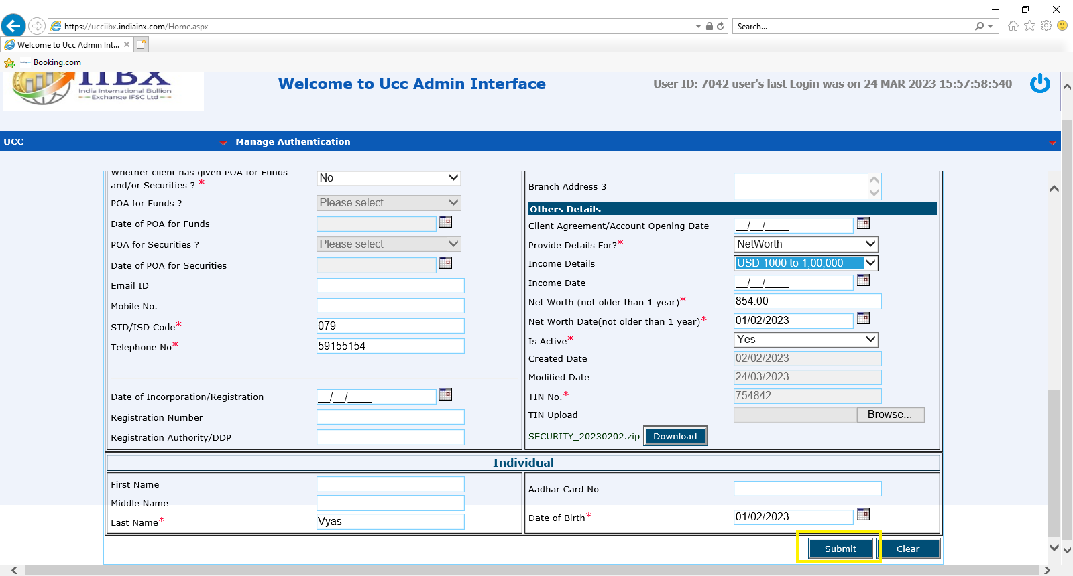
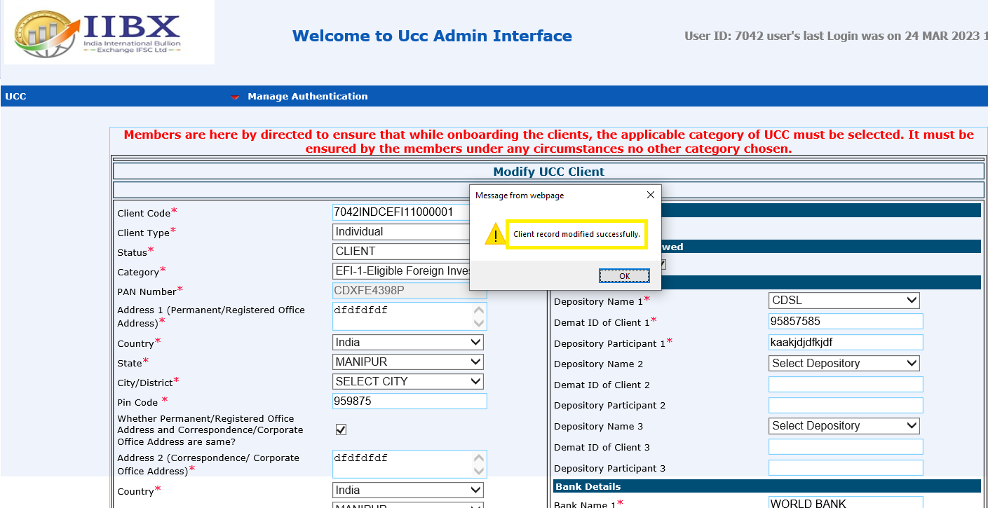
Frequently Asked Questions
5. How can I modify my existing UCC?
Answer - Step – 3 of 4 – Modify UCC Client modification menu label will get activated.
Step – 4 of 4 – Make necessary changes and click on Submit button.
“Client record modify successfully” messages display on screen.
Step - 3
Step - 4

Slide 24
For any query/assistance request you to kindly connect Trading Operations department of IIBX with error screenshot on mail at trading.operations@iibx.co.in
Thank You…….

