Slide 1


SEZ Entities and Holders of RCMC issued by GJEPC
Understanding IIBX Ecosystem

Slide 2
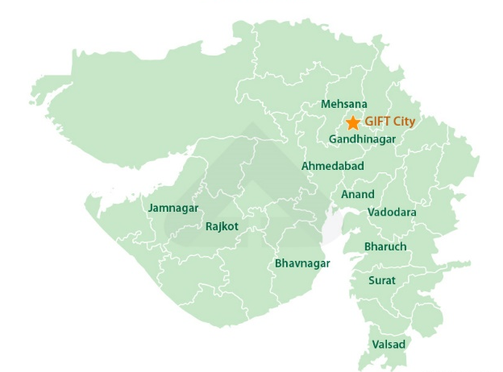




IIBX – GIFT City, Gandhinagar, Gujarat

Slide 3
International Financial Services Centres Authority
Role of IFSCA
The IFSCA is a unified authority for the development and regulation of financial products, financial services and financial institutions in the International Financial Services Centres (IFSC) in India. The IFSCA has been established as a unified regulator under the International Financial Services Centre Authority Act passed by the Indian Parliament in 2019 with a holistic vision in order to promote ease of doing business in IFSC and provide world class regulatory environment.
Purpose of IFSCA
The main objective of the IFSCA is to develop a strong global connect and focus on the needs of the Indian economy as well as to serve as an international financial platform for the entire region and the global economy as a whole.
Prior to the establishment of IFSCA, the domestic financial regulators, namely, RBI, SEBI, PFRDA and IRDAI regulated the business in IFSC.

Slide 4








Promoters of India International Bullion Exchange IFSC Ltd.
Promoted by the following MIIs through India International Bullion Holding IFSC Ltd. (IIBH)
20%
20%
10%
20%
10%
20%
Shareholding pattern in India International Bullion Holding IFSC Ltd. is shown above.

Slide 5
Evolution of IIBX
FEBRUARY 2020
DECEMBER 2021
MAY 10, 2023
JUNE 15, 2026
Finance Minister announced to set up an International Bullion Exchange at GIFT IFSC
License Issue Date
ICEGATE Integration
Enabled RCMC Holders issued by GJEPC
DECEMBER 2020
JULY 29, 2022
JAN 02, 2026
IFSCA notifies International Financial Services Centres Authority ( Bullion Exchange ) Regulations, 2020
Hon’ble Prime Minister of India launched IIBX
Enabled SEZ Units and Advance Authorisation holders to import Gold and Silver through IIBX

Slide 6


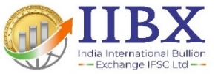
IIBX Ecosystem
Qualified Jewelers, SEZ units, Advance Authorisation holders, RCMC Holders can import gold and silver; valid TRQ holders can import gold
Qualified Jewellers & TRQ Holders
Qualified Suppliers
International Bullion Banks,
Refineries and Bullion Traders
being onboarded
Unified Regulator
SEZ units with a valid LOA and jewellery export as an authorised operation can import silver bars (HS Code 71069221) through IIBX without Qualified Jeweller status
SEZ Units
Vaulting facilities with 3 vaults in GIFT City, 2 at Chennai. Vaults at SEEPZ Mumbai & Kolkata expected soon
Vaults
SCC Banks
India International Depository IFSC Ltd.(IIDI)
maintains Demat Accounts
Nominated Banks Authorized to import Gold and Silver in India as Special Category Client
IIDI
Trading Members
International
Clients
International Clients can hedge the Gold & Silver Price risk, invest in BDRs
IFSC entities & IFSC Banking Units permitted to act as TM/CM

Slide 7
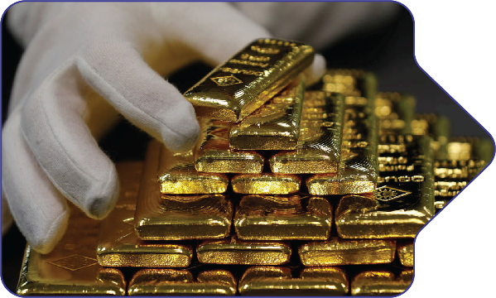

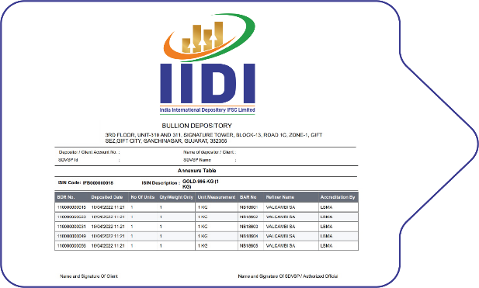
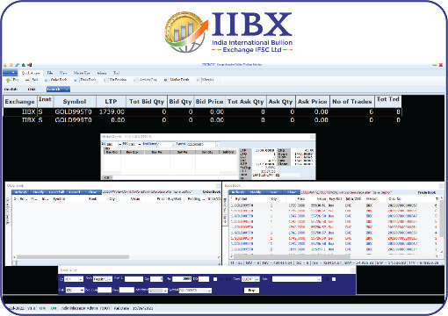
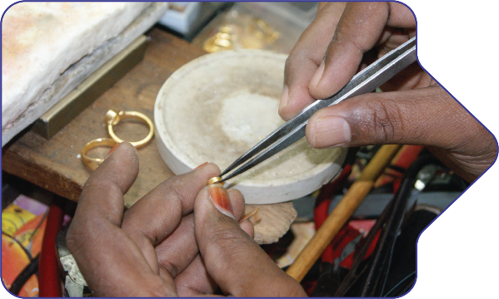
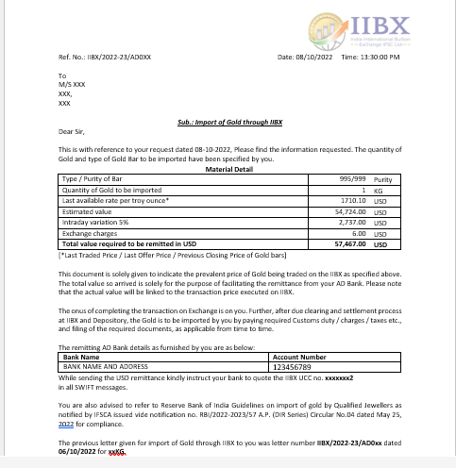

Process Flow for Gold and Silver Import though IIBX….1/2
Sellers
Bullion Dealers/Banks
Deposit Bullion at IFSC Vaults and Demat process
Generation of Bullion Depository Receipt (BDR)
Place Sell Order on IIBX Trading System
Buyers
Qualified Jewellers
AD letter by IIBX for USD remittance by QJ
INR to USD and receipt of USD in IIBX Clearing
Place Buy Order on IIBX Trading System

Slide 8
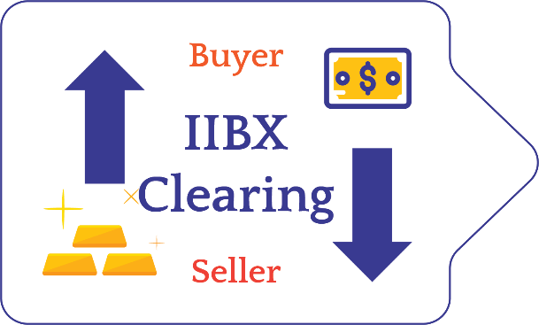

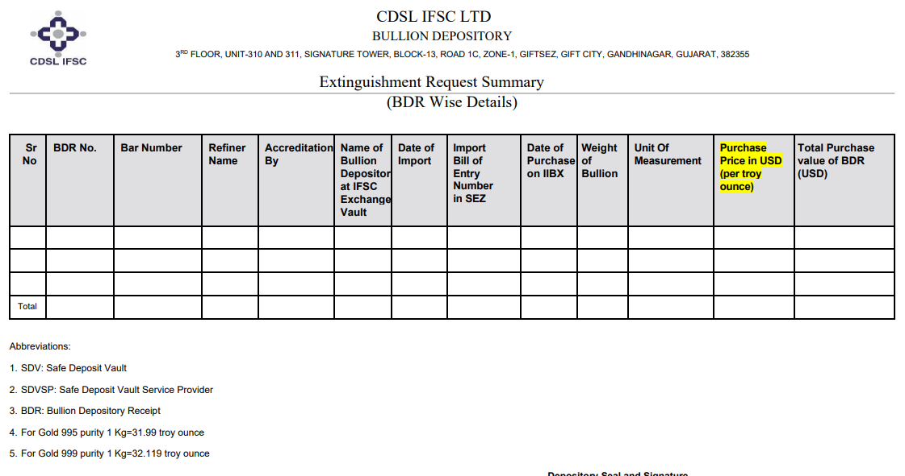
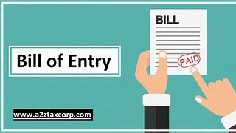


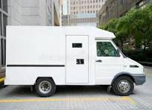
Process Flow for Gold and Silver Import though IIBX…..2/2
Buy and Sell Order Matches
IIBX - Clearing
Transfer of BDR to Buyer Demat Account by IIDI
Extinguishment of Bullion Depository Receipts
Filing of Bill of Entry
Customs Clearance
Remat of BDR into Physical Gold at Vault
Door Delivery across India within 24 Hours

Slide 9
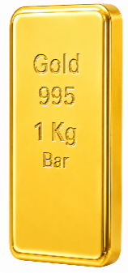
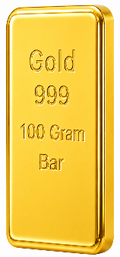
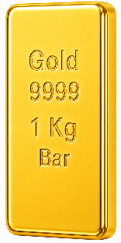
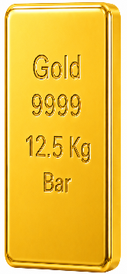
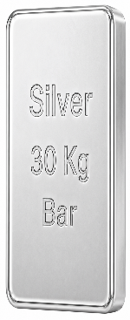
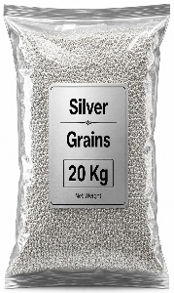
Existing T+0 Products, Market Hours and Settlement Type
995 1Kg Bar
999 100
Gram Bar
LBMA Good Delivery
Market Hours & Settlement
GOLD 995 T+0
GOLD MINI 999 T+0
GOLD 9999 T+0
GOLD 12.5 9999 T+0
SILVER Bar T+0
SILVER Grains T+0
LBMA
UAEGD
UAEGDTRQ
RECYCLED
LBMA
UAEGD
UAEGDTRQ
RECYCLED
MARKET HOURS : 09:00 HRS.TO 21:30 HRS.(IST)
BDR SETTLEMENT : AT EVERY 30 MINUTES
UAE Good Delivery
Fund Settlement : AT 12:15, 15:15,
18:45 & 21:30 (IST)
9999 1 Kg Bar
9999
12.5 Kg Bar
UAEGD GOLD 995 T+0
UAEGD GOLD 999 T+0
UAEGD GOLD 9999 T+0
UAEGD GOLD 12.5 9999 T+0
UAEGDTRQ GOLD 995 T+0
UAEGDTRQ GOLD 999 T+0
UAEGD SILVER Bar T+0
UAEGD SILVER Grains T+0
UAEGDCEPA SILVER Grains T+0
LBMA
UAEGD
RECYCLED
LBMA
UAEGD
RECYCLED
T+0 SETTLEMENT FEATURES
T+0 SETTLEMENT CONTRACTS
Silver
30 Kg Bar
Silver
20 Kg Grains
100% EARLY PAY-IN OF FUNDS & SECURITIES
Recycled Gold
DELIVERY - COMPULSORY IN BULLION DEPOSITORY RECEIPTS
LBMA
UAEGD
LBMA
UAEGD
CEPA-UAGED
RECYCLED GOLD 995 T+0
RECYCLED GOLD 999 T+0
RECYCLED GOLD 9999 T+0
RECYCLED GOLD 12.5 9999 T+0
GIFT City, Chennai Vaults and other IFSCA Approved Vaults via IIDI

Slide 10
Existing T+2 Products, Market Hours and Settlement Type
LBMA Good Delivery
Market Hours
995 1Kg Bar
999 100
Gram Bar
Market Hours : 09:00 Hrs to 21:30 Hrs (IST)
GOLD 995 T+2
GOLD MINI 999 T+2
GOLD 9999 T+2
GOLD 12.5 9999 T+2
SILVER Bar T+2
LBMA
UAEGD
UAEGDTRQ
RECYCLED
Initial Margin
LBMA
UAEGD
UAEGDTRQ
RECYCLED
Seller : 100% BDR
Buyer : Gold -Minimum 10%- or 2-days VAR (whichever is higher)
  : Silver -Minimum 15%- or 2-days VAR (whichever is higher)
UAE Good Delivery
9999 1 Kg Bar
9999
12.5 Kg Bar
Settlement Days
UAEGD GOLD 995 T+2
UAEGD GOLD 999 T+2
UAEGD GOLD 9999 T+2
UAEGD GOLD 12.5 9999 T+2
UAEGDTRQ GOLD 995 T+2
UAEGDTRQ GOLD 999 T+2
UAEGD SILVER Bar T+2
The Buyer has flexibility of early settlement on T+1 for Balance Funds
Final Settlement will be on T+2 ( on or before 17:30 Hrs of T+2 Day)
LBMA
UAEGD
RECYCLED
LBMA
UAEGD
RECYCLED
BDR Pay out ( On receipt of Funds )
T+1 Pay Out Cycles
12:30 Hrs
15:30 Hrs
17:30 Hrs
21:30 Hrs
T+2 Pay Out Cycles
12:30 Hrs
15:30 Hrs
17:30 Hrs
Silver
30 Kg Bar
Penalty Clause
Recycled Gold
Buyer default beyond T+2 attracts 3% Penalty + Replacement Cost
For more information, please refer to the Contract Specifications
LBMA
UAEGD
RECYCLED GOLD 995 T+2
RECYCLED GOLD 999 T+2
RECYCLED GOLD 9999 T+2
RECYCLED GOLD 12.5 9999 T+2
Delivery Vaults
GIFT City, Chennai Vaults and other IFSCA Approved Vaults via IIDI

Slide 11
Global First Initiatives
One to one congruence between BDR and physical Bar/Grain bag.
IIBX is first Exchange globally to introduce ‘Every 30 minutes Settlement of BDRs’
Direct Pay-out to Buyers have been introduced wherein the BDRs are directly credited to the Buyer’s Demat account without the intervention of the intermediate Clearing and Trading Members.
Fund settlement cycle is now activated 4 times at every at 12:15 ,15:15, 18:45 & 21:30 .
Multiple Fund settlement Cycles reduces TAT of overall trade process, encouraging Qualified Suppliers to offer best rates and manage Bullion shipment cycles and Cash flow of funds more efficiently.
These innovative solutions have paved the way for same day delivery of Bullion through IIBX ecosystem for the Qualified Jewellers / TRQ Holders.

Slide 12
Bullion for SEZ Exporters of Jewellery ( SEZ to SEZ Transfer )
Development Commissioner of GIFT SEZ has issued a public notice on 06/2023-24 whereby Standard Operating Procedure (SOP) has been issued in accordance with Rule 38 of SEZ rules, 2006, Which address the need for Zone to Zone transfer of bullion imported by Qualified Jewellers through IIBX.
The SEZ Division of the Department of Commerce, Ministry of Commerce & Industry, Government of India, has issued letter No.J.16/3/2007-SEZ Vol-V, dated June 22, 2024, to all Development Commissioners of Special Economic Zones regarding the implementation of ICEGATE at all SEZs, except IT/ITES SEZs and FTWZs, effective from July 1, 2024.

Slide 13
Zone to Zone Transfer SOP
QJ to apply in Form 1 through Vault Manager (VM) in GIFT-SEZ
Action by receiving SEZ Unit (Approve)
Request received in specified officer’s menu for approval (Approve)
VM to seal goods in presence of specified officer and carries to receiving SEZ
Vault Manager bond to be debited
Receiving SEZ confirms receipt of goods
VM’s bond to be credited and receiving SEZ Unit bond to be debited
Zone_Zone transfer PN 06 GIFT (Bullion).pdf

Slide 14
Qualified Jeweller (QJ)
The entity shall have a minimum net worth of INR 15 crore as per its latest audited annual financial statements or audited / unaudited / reviewed quarterly/half-yearly financial statements.
The entity must have filed due GST returns up to the preceding month/quarter, as applicable, prior to making an application to the IIBX
The entity shall submit a certificate from a practicing chartered accountant or a practicing cost accountant or a practicing company secretary confirming that either 60% of the annual turnover in each of the last three financial years along with the current financial year up to the date of application, or 90% of the annual turnover in the previous financial year along with the current financial year up to the date of application, is derived from dealing in goods falling under ITC(HS) Codes 7106, 7108, 7113, 7114 and 7118 (Chapter 71).
Qualified Jewellers shall satisfy the Fit and Proper Person criteria at all time as specified by IFSCA.
    The eligible entity shall approach IIBX for notification by IFSCA as a Qualified Jeweller.

Slide 15
SEZ Units as a Qualified Jeweller (QJ)
Pursuant to the IFSCA Consolidated Circular dated 2 January 2026 and 15 June 2026, SEZ Units holding a valid Letter of Approval (LoA) and have export of jewellery as one of its authorised operations are permitted to onboard and import gold and silver through IIBX.
SEZ Unit shall submit a certificate from a practicing chartered accountant or a practicing cost accountant or a practicing company secretarycertifying that:
    a) At least 35% of annual turnover in each of the preceding three financial years and the current financial year up to the date of application is from goods under ITC(HS) Codes 7113, 7114 and 7118;
    b) Annual export turnover of at least ₹5 crore in goods under ITC(HS) Code 7113 during each of the preceding three financial years.
    No minimum net worth is required.
Qualified Jewellers shall satisfy the Fit and Proper Person criteria at all time as specified by IFSCA.
    The eligible SEZ Unit shall approach IIBX for notification by IFSCA as a Qualified Jeweller.

Slide 16
Advance Authorization Holders as a Qualified Jeweller (QJ)
Pursuant to the IFSCA Consolidated Circular dated 2 January 2026 and 15 June 2026, entities holding a valid Advance Authorization (AA) issued by DGFT are permitted to onboard and import gold and silver through IIBX
Notwithstanding the eligibility criteria specified for Regular QJs, such entity shall be eligible to apply through IIBX for notification by IFSCA as a Qualified Jeweller.
The Qualified Jeweller notified under this category shall participate on IIBX only through a Bullion Trading Member.
Imports shall be restricted to the ITC(HS) codes mentioned in the Advance Authorisation issued by DGFT.
Imports through IIBX shall be undertaken only for export obligations specified in the Advance Authorisation and its Condition Sheet.
Qualified Jewellers shall satisfy the Fit and Proper Person criteria at all time as specified by IFSCA.
No minimum net worth and Turnover is required.

Slide 17
RCMC Holders as a Qualified Jeweller (QJ)
Pursuant to the IFSCA Consolidated Circular dated 15 June 2026, entities holding a valid Registration-cum-Membership Certificate (RCMC) issued by The Gem & Jewellery Export Promotion Council (GJEPC) are permitted to onboard and import gold and silver through IIBX.
Notwithstanding the eligibility criteria specified for Regular QJs, such entity shall be eligible to apply through IIBX for notification by IFSCA as a Qualified Jeweller.
Imports shall be undertaken only for export purposes and in compliance with applicable conditions.
Qualified Jewellers shall satisfy the Fit and Proper Person criteria at all time as specified by IFSCA.
No minimum net worth and Turnover is required.

Slide 18
Silver Imports under HS 71069221
Pursuant to IFSCA Consolidated Circular Dated 15 June 2026 and DGFT Notification No. 17/2026-27 dated 16 May 2026, Policy Condition No. 7 of Chapter 71 of ITC(HS), 2022 permits import of silver bars under HS Code 71069221 by SEZ Units holding a valid Letter of Approval (LOA) and having export of jewellery as one of their authorized operations
No requirement to be notified as a Qualified Jeweller (QJ) for imports under HS 71069221
No minimum net worth or turnover criteria required for silver imports under this HS code
The eligible SEZ Units shall approach Bullion Trading Members for imports under this HS code

Slide 19
Valid India UAE TRQ holder
Valid holders of India - UAE Tariff Rate Quota (TRQ) license / authorisation as allotted by DGFT are eligible to apply for being notified as ‘India-UAE TRQ holders’ by the IFSCA, for the purpose of such imports.
Such valid holders of India – UAE TRQ license, need to submit an application to IIBX along with a copy of valid TRQ license as issued by the DGFT, a copy of Import Export Code (IEC) issued by DGFT and a self certified copy of GST certificate issued by CBIC along with KYC details.
Post internal scrutiny, IIBX will send the application of valid India – UAE TRQ holder to IFSCA for its notification.
After being notified by the IFSCA, such valid India-UAE TRQ holders shall be permitted to participate on IIBX, through Bullion Trading Members, for transacting in (‘buying’ only) UAEGD gold for import under the India-UAE CEPA, subject to the quota.
QJs that hold valid TRQ licence/authorization under the India-UAE CEPA shall also be permitted to import UAEGD gold through IIBX under the India-UAE CEPA. Such QJs shall not be required to apply separately for being notified as ‘India-UAE TRQ holders’ by the IFSCA.

Slide 20
Hedging Participation in Gold & Silver Futures at IIBX
Gold and Silver Futures :
  Gold and Silver Futures are financial contracts that allow buyers and sellers to agree on the price of gold or silver to be exchanged at a future date. These contracts are used to protect against price fluctuations in the gold and silver markets
RBI Guidelines:
  In line with RBI Circular No. A.P. (DIR Series) Circular No. 20, dated December 12, 2022, Domestic residents other than individuals having exposure to Price Risk of Gold/Silver are allowed to hedge such exposure on the India International Bullion Exchange (IIBX). This offers a regulated platform for managing price risk effectively.
Gold and Silver Futures at IIBX :
  Secure your bullion exposure and manage price volatility risks with USD-denominated Gold and Silver Futures contracts, aligned with global standards, offered by IIBX – India’s 1st International Bullion Exchange under IFSCA’s regulatory framework.
  No Need to set up Subsidiary or Branch overseas:
  Entities setting up overseas Subsidiary or Branch for participating on international Exchanges for Gold and Silver can now avail US Dollar based pricing for Gold and silver Futures by participating and hedging their price risk through IIBX

Slide 21
Gold and Silver Futures- Eligibilities and Key Contract Specifications
Eligible Participants
All below having exposure to Price Risk of Gold/Silver
Key Contract Specifications for Gold and Silver Futures
Refiners
Bullion Dealers
Bullion Importers
Jewellery Exporters
Domestic Jewellers
Residents other than individuals
Particulars | Gold Contracts | Silver Contracts
Contract Availability | 12 consecutive monthly running contracts | 12 consecutive monthly running contracts
Trading Unit | 1 Kg | 30 Kg
Price Quotation | US Dollars per Troy Ounce | US Dollars per Troy Ounce
Trading Hours | Monday to Friday: 09:00 hrs to 23:30 hrs (IST) | Monday to Friday: 09:00 hrs to 23:30 hrs (IST)
Initial Margin | 6% Initial Margin (+1 ELM) or VaR-based Margin (MPOR Adjusted), whichever is higher | 10% Initial Margin (+1 ELM) or VaR-based Margin (MPOR Adjusted), whichever is higher
Delivery Mechanism | Delivery based on intention matching | Delivery based on intention matching
Key Highlights
RBI Permits Domestic Entities to Hedge Bullion Price Risk through IIBX
USD-Denominated Gold & Silver Futures under IFSCA Framework
Global Standard Contracts with No Overseas Subsidiary Requirement

Slide 22
Onboarding process of Hedgers in Gold and Silver Futures at IIBX
1. AD Bank US Dollar Limit Sanction
    Authorized Dealer (AD) Banks approve US Dollar remittance limits for domestic entities seeking to hedge Gold and Silver price risk in USD through IIBX Gold and Silver Futures.
2. Application for Trading / Clearing Account Setup
    Once limits are sanctioned by the AD Bank, applicants need to open Trading/Clearing Accounts with IFSCA-registered Bullion Trading/Clearing Members.
Note: Onboarding is required only with IFSCA-registered Bullion Trading/Clearing Members for participation in Gold and Silver Futures at IIBX; no separate onboarding at IIBX is needed.

Slide 23
Onboarding process of Qualified Jeweller / Valid India TRQ Holder at IIBX
IFSCA Notification
    Application Submission:
    The applicant registers and submits their application with required documents in the specified format via the Membership Application Portal at:
    https://membership.iibx.co.in/register.aspx
    IIBX Review:
    The IIBX Membership Team reviews the application and forwards it to the IFSCA once it meets the eligibility criteria.
    IFSCA Evaluation and Notification:
    The IFSCA evaluates the application and, after completing due diligence, notifies the applicant as a Qualified Jeweller or Valid India–UAE TRQ Holder.
2. Demat Account Setup
    Notified Qualified Jewellers / Valid India UAE TRQ Holders are required to open a Demat Account with Depository Participants enabled by IIDI.
3. Trading / Clearing Account Setup
    Notified Qualified Jewellers / Valid India UAE TRQ Holders need to obtain a UID and Unique Client Code (UCC).

Slide 24
Application Process
at
IIBX

Slide 25
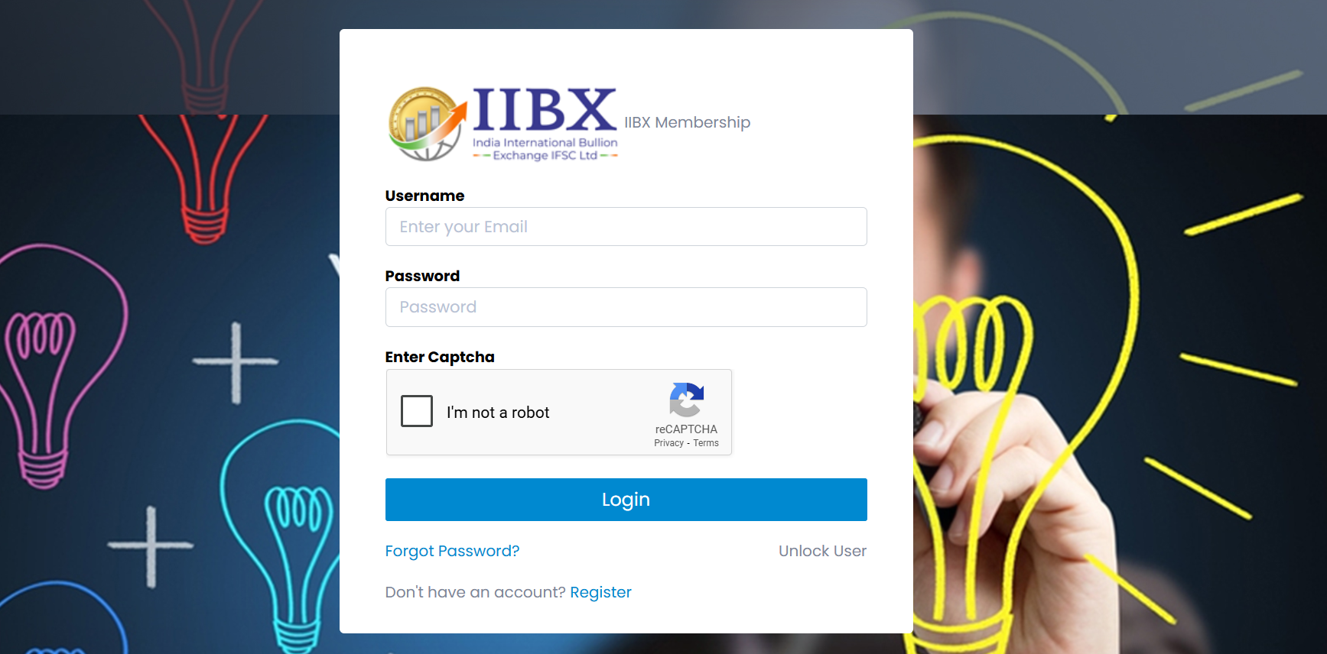

Open your preferred web browser, click on the address bar, type and register
https://membership.iibx.co.in

Slide 26
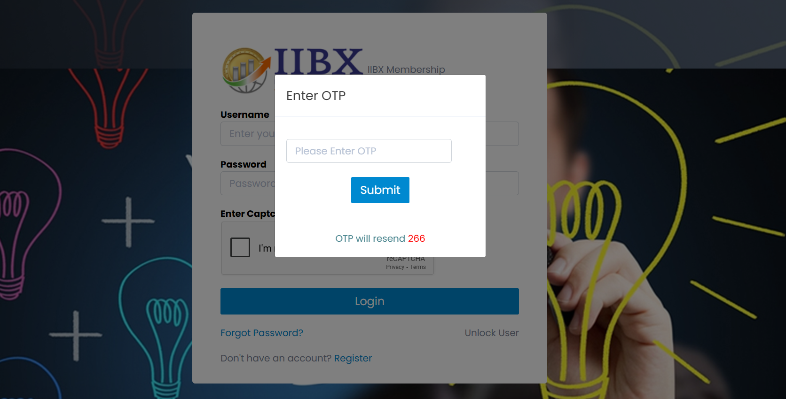

Slide 27
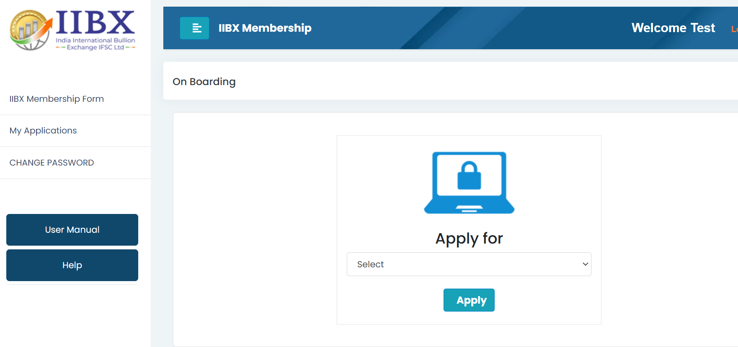

Slide 28
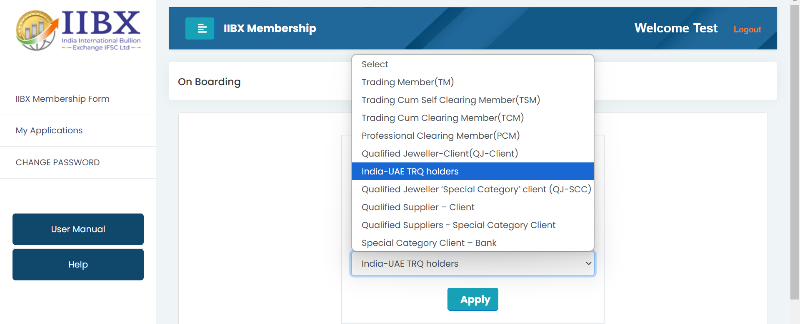

Slide 29
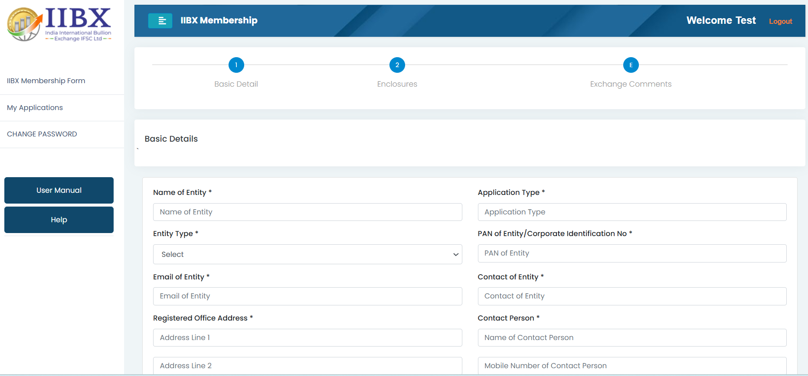



Note : Fill all Basic Details – Click Enclosure – Click Submit – ( Application ID will be generated )

Slide 30
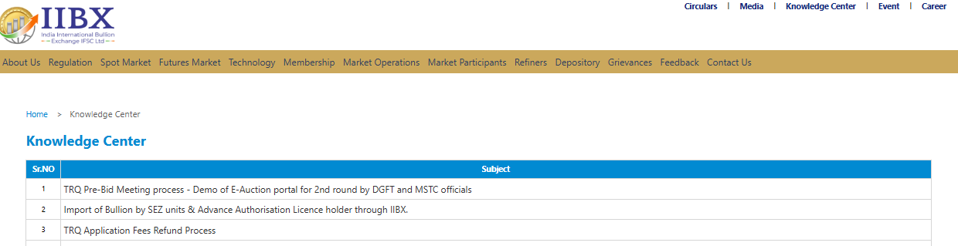
Knowledge center at IIBX website
IIBX's website now includes a knowledge center aimed at educating and spreading awareness about IIBX services

Slide 31

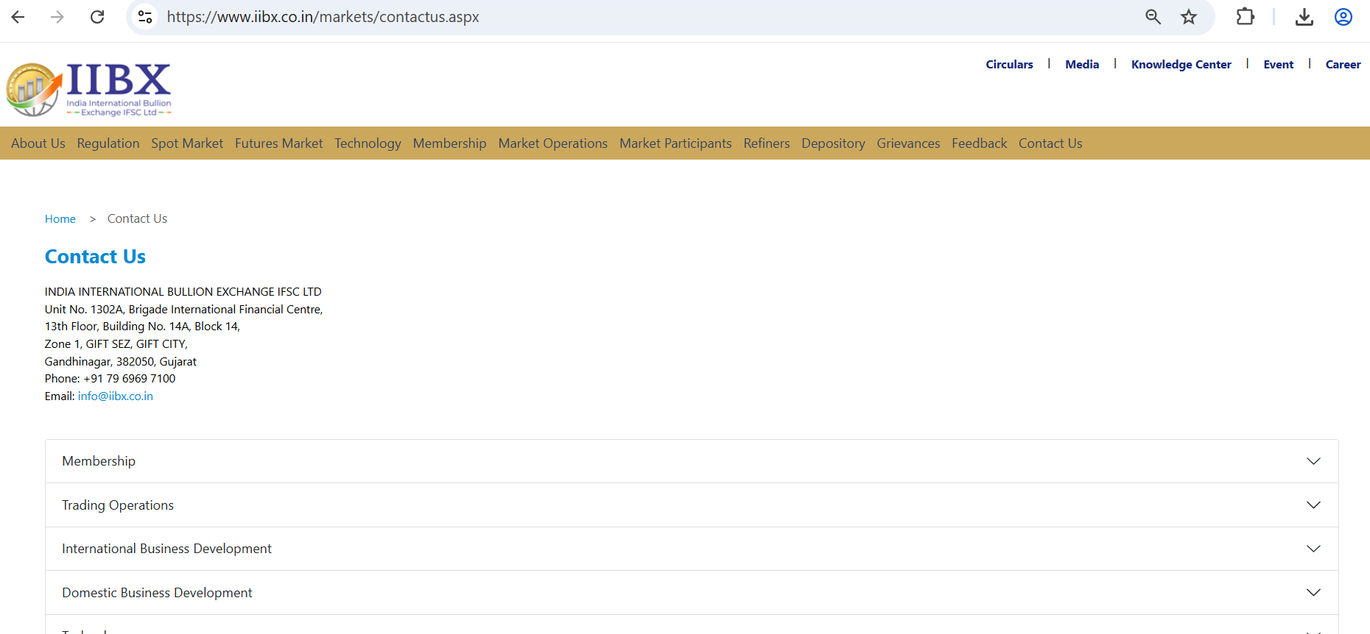
IIBX Contact Points
https://www.iibx.co.in

Slide 32
Thank You

