Slide 1



Import of Bullion by SEZ Units &
Advance Authorisation holders through IIBX

Slide 2


India’s first International Financial Services Center (IFSC) is set up under Special Economic Zone Act, 2005 (“SEZ Act 2005”)
Government of India operationalized International Financial Services Center (IFSC) at GIFT Multi Services SEZ in April 2015
GIFT is conceptualized as a global Financial and IT Services hub, a first of its kind in India, designed to be at or above par with globally benchmarked financial centers

Slide 3

International Financial Services Centres Authority
Role of IFSCA
The IFSCA is a unified authority for the development and regulation of financial products, financial services and financial institutions in the International Financial Services Centres (IFSC) in India. The IFSCA has been established as a unified regulator under the International Financial Services Centre Authority Act passed by the Indian Parliament in 2019 with a holistic vision in order to promote ease of doing business in IFSC and provide world class regulatory environment.
Purpose of IFSCA
The main objective of the IFSCA is to develop a strong global connect and focus on the needs of the Indian economy as well as to serve as an international financial platform for the entire region and the global economy as a whole.
Prior to the establishment of IFSCA, the domestic financial regulators, namely, RBI, SEBI, PFRDA and IRDAI regulated the business in IFSC.

Slide 4








Promoters of India International Bullion Exchange IFSC Ltd.
Promoted by the following MIIs through India International Bullion Holding IFSC Ltd. (IIBH)
20%
20%
10%
20%
10%
20%
Shareholding pattern in India International Bullion Holding IFSC Ltd. is shown above.

Slide 5






Evolution of IIBX
DECEMBER 2020
July 29, 2022
December 21, 2023
IFSCA notifies International Financial Services Centres Authority (Bullion Exchange) Regulations, 2020
Hon’ble Prime Minister of India launched IIBX
SOP for SEZ to SEZ transfer issued by the DC, GIFT SEZ
FEBRUARY 2020
DECEMBER 2021
May 10, 2023
January 02, 2026
Finance Minister announced to set up an International Bullion Exchange at GIFT IFSC
License Issue Date
Integration with ICEGATE the Customs Portal
IFSCA issues guidelines for onboarding of SEZ entities & AA holders as QJs

Slide 6


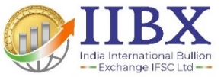
IIBX Ecosystem
Qualified Jewellers in DTA, SEZ entities & Advance Authorisation holders can import Gold and Silver & valid TRQ holders can import Gold
Qualified Jewellers & TRQ Holders
Qualified Suppliers
International Bullion Banks,
Refineries and Bullion Traders
being onboarded
Unified Regulator
DTA entities can Import Silver bars under ITC (HS) Code 71069221. Clients from DTA /India can hedge the Gold Price risk
DTA Clients
Vaulting facilities with 3 vaults in GIFT City, 2 at Chennai. Vaults at SEEPZ Mumbai & Kolkata expected soon
Vaults
SCC Banks
India International Depository IFSC Ltd.(IIDI)
maintains Demat Accounts
Nominated Banks Authorized to import Gold and Silver in India as Special Category Client
IIDI
Trading Members
International
Clients
International Clients can hedge the Gold & Silver Price risk, invest in BDRs
IFSC entities & IFSC Banking Units permitted to act as TM/CM

Slide 7
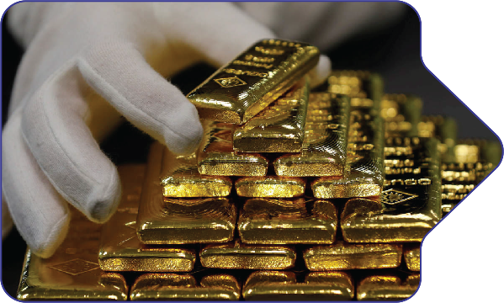

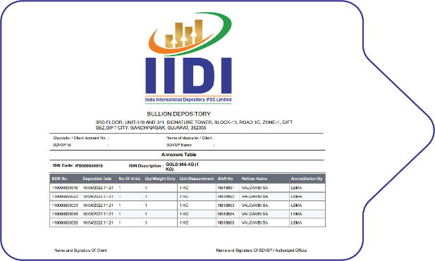
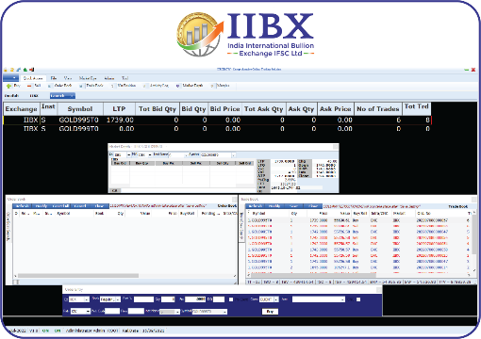
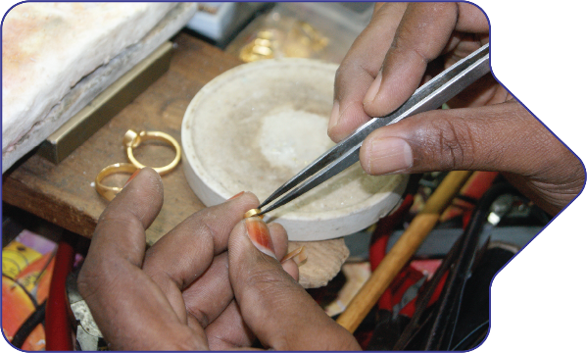
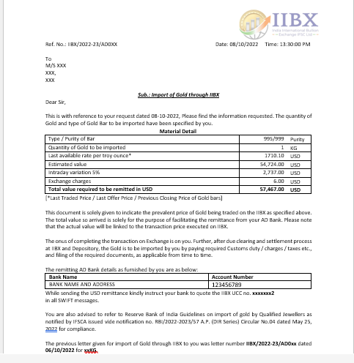

Process Flow..1
Sellers
Bullion Dealers/Banks
Deposit Bullion at IFSC Vaults and Demat process
Generation of Bullion Depository Receipt (BDR)
Place Sell Order on IIBX Trading System
Buyers
Qualified Jewellers
AD letter by IIBX for USD remittance by QJ
INR to USD and receipt of USD in IIBX Clearing
Place Buy Order on IIBX Trading System

Slide 8
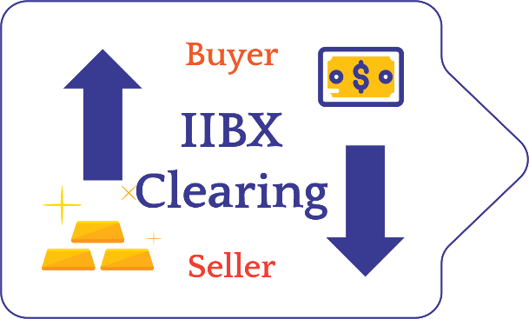

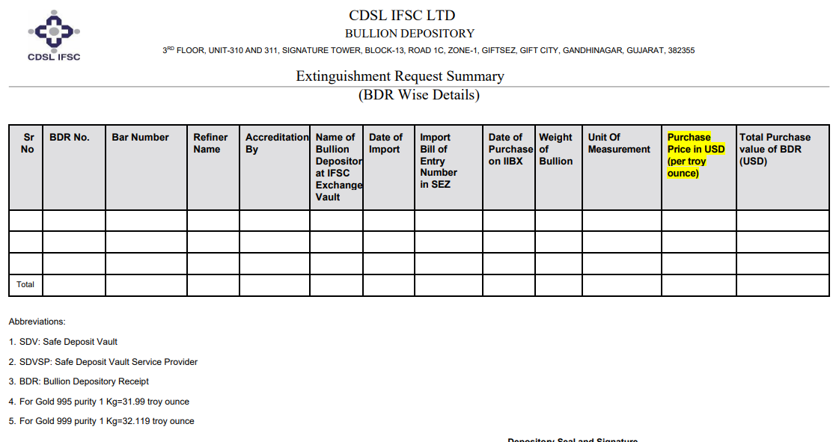
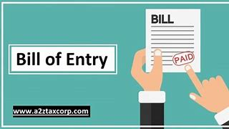



Process Flow..2
Buy and Sell Order Matches
IIBX - Clearing
Transfer of BDR to Buyer Demat Account by IIDI
Extinguishment of Bullion Depository Receipts
Filing of Bill of Entry
Customs Clearance
Remat of BDR into Physical Gold at Vault
Door Delivery across India within 24 Hours

Slide 9

Existing T+0 Products, Market Hours and Settlement Type
Gold Products live & proposed at IIBX – GIFT City & Chennai Contracts
LBMA Good Delivery Bars
UAE Good Delivery Bars
*Recycled Gold Products (Proposed)
GOLD
1 KG,
12.5KG
GOLD
MINI
100
GRAMS
GOLD
1 KG,
12.5KG
GOLD
MINI
100
GRAMS
GOLD
1KG
GOLD
MINI
100
GRAMS
GOLD 995 T+0
GOLD MINI 999 T+0
GOLD 995 T+0
GOLD MINI 999 T+0
LBMA, UAEGD & Other
GOLD 995 T+0
LBMA, UAEGD & Other
GOLD MINI 999 T+0
GOLD 9999 T+0
GOLD 9999 T+0
LBMA, UAEGD, Other
GOLD 9999 T+0
Market Hours
9:00 Hrs. to 21:30 Hrs. (IST)
T+0 Settlement Contracts
100% Early Pay-in of Funds & Securities
Delivery - Compulsory in Bullion Depository Receipts
Delivery Center – Gift City & Chennai Vaults
BDR Settlement
at Every 30 Minutes
Fund Settlement
at 12:15 ,15:15, 18:45 & 21:30 (IST)

Slide 10
Existing T+0 Products, Market Hours and Settlement Type
Silver Products live & proposed at IIBX – GIFT City & Chennai Contracts
LBMA Good Delivery Bars
UAE Good Delivery Bars
*Recycled LBMA / UAE Good Delivery & OTH Bars (*Proposed)
Silver Grains
(20 Kg)
Silver Bars (30Kg)
Silver Grains
(20 Kg)
Silver Bars (30Kg)
Silver Grains
(20 Kg)
Silver Bars (30Kg)
SILVER GRAINS T+0
SILVER GRAINS T+0
*UAEGDCEPA SILVER GRAINS T+0
*Only at GIFT CITY
SILVER BARS T+0 ( LBMA )
SILVER BARS T+0 (UAEGD)
SILVER BARS T+0 (OTH)
SILVER BARS T+0
SILVER BAR T+0
SILVER GRAINS T+0 ( LBMA )
SILVER GRAINS T+0 (UAEGD)
SILVER GRAINS T+0 (OTH)
Market Hours
9:00 Hrs. to 21:30 Hrs. (IST)
T+0 Settlement Contracts
100% Early Pay-in of Funds & Securities
Delivery - Compulsory in Bullion Depository Receipts
Delivery Center – Gift City & Chennai Vaults
BDR Settlement
at Every 30 Minutes
Fund Settlement
at 12:15 ,15:15, 18:45 & 21:30 (IST)

Slide 11
Global First Initiatives
One to one congruence between BDR and physical Bar/Grain bag.
IIBX is first Exchange globally to introduce ‘Every 30 minutes Settlement of BDRs’
Direct Pay-out to Buyers have been introduced wherein the BDRs are directly credited to the Buyer’s Demat account without the intervention of the intermediate Clearing and Trading Members.
Fund settlement cycle is now activated 4 times at every at 12:15 ,15:15, 18:45 & 21:30 .
Multiple Fund settlement Cycles reduces TAT of overall trade process, encouraging Qualified Suppliers to offer best rates and manage Bullion shipment cycles and Cash flow of funds more efficiently.
These innovative solutions have paved the way for same day delivery of Bullion through IIBX ecosystem for the Qualified Jewellers.

Slide 12
Import of Gold & Silver through IIBX for
SEZ Units

Slide 13
Eligibility Criteria for SEZ Units
Pursuant to the IFSCA Circular dated 2 January 2026, SEZ units holding a valid Letter of Approval (LoA) and export of jewellery as authorised operations are permitted to onboard and import gold and silver through IIBX
Entry norms have been relaxed to encourage wider SEZ participation, including a reduced minimum net worth requirement to ₹5 crore
₹5 crore annual jewellery export turnover under HSN (HS 7113)
35% annual turnover in each of last 3 financial years are through dealing in goods under HSN 7113, 7114 and 7118 of Chapter 71 (These HSNs covers Jewellery)
Eligible SEZ jewellery exporters are invited to apply as Qualified Jewellers (QJ)

Slide 14
Advantages for SEZ Unit Exporters from IIBX
No Counter party risk
Smaller denominations as low as 100 Gms available
No need to open LC with the Banks
No need to pre-book the Bullion. 24*7 Availability of Bullion
No cash margin blocked for duty foregone amount
Easy access to recycled Gold
SOP for SEZ to SEZ transfer of Bullion is issued
Mumbai SEEPZ vault is in process
Exporters dollar account can be opened in IBUs at GIFT IFSC enabling quick dollar flow to IIBX without any forex conversion

Slide 15
Foreign Currency Account for SEZ unit Exporters
RBI wide Master Directions updated on November 14, 2025 has permitted the exporters;
  A person resident in India, being an exporter, may open, hold, and maintain a Foreign Currency Account with a bank outside India/in an International Financial Services Centre (IFSC) for the realisation of full export value and advance remittance received towards the export of goods or services.
  Funds in this account may be utilised by the exporter for making import payments into India or repatriated into India within a period not exceeding the end of three months, in the case of accounts maintained with banks in an International Financial Services Centre (IFSC).

Slide 16
Bullion for SEZ Exporters of Jewellery
Development Commissioner of GIFT SEZ has issued a public notice on 06/2023-24 whereby Standard Operating Procedure (SOP) has been issued in accordance with Rule 38 of SEZ rules, 2006, Which address the need for Zone to Zone transfer of bullion imported by Qualified Jewellers through IIBX.
The SEZ Division of the Department of Commerce, Ministry of Commerce & Industry, Government of India, has issued letter No.J.16/3/2007-SEZ Vol-V, dated June 22, 2024, to all Development Commissioners of Special Economic Zones regarding the implementation of ICEGATE at all SEZs, except IT/ITES SEZs and FTWZs, effective from July 1, 2024.

Slide 17
Zone to Zone Transfer SOP
QJ to apply in Form 1 through Vault Manager (VM) in GIFT-SEZ
Action by receiving SEZ Unit (Approve)
Request received in specified officer’s menu for approval (Approve)
VM to seal goods in presence of specified officer and carries to receiving SEZ
Vault Manager bond to be debited
Receiving SEZ confirms receipt of goods
VM’s bond to be credited and receiving SEZ Unit bond to be debited
Zone_Zone transfer PN 06 GIFT (Bullion).pdf

Slide 18
Import of Gold & Silver through IIBX for
Advance Authorisation Holders

Slide 19
Eligibility Criteria for Advance Authorisation (AA) Holders
Pursuant to the IFSCA Circular dated 2 January 2026, entities holding a valid AA issued by DGFT are permitted to onboard and import gold and silver through IIBX
Turnover based or net worth based eligibility norms have been relaxed, allowing all AA holders to participate irrespective of turnover and Net worth
AA holders are invited to apply to become as Qualified Jeweller
AA holders may import gold/silver strictly in accordance with the HS codes, quantity, and conditions specified in the Advance Authorisation licence

Slide 20
Advantages for Advance Authorisation (AA) Holders
Import of Bullion through IIBX is permitted under HSNs as mentioned in the AA licence
Smaller denominations as low as 100 Gms available
No Counter party risk
Participation is allowed only as a client of a Bullion Trading Member on IIBX
No need to pre-book the Bullion. 24*7 Availability of Bullion
No cash margin blocked for duty foregone amount.
Bond to be submitted to Jurisdictional Customs as hitherto
Easy access to recycled Gold
Mumbai SEEPZ vault is in process
Exporters dollar account can be opened in IBUs at GIFT IFSC enabling quick dollar flow to IIBX without any forex conversion

Slide 21
Import of Bullion by Exporters through IIBX under Advance Authorisation Scheme
Pre Conditions
  Valid Advance Authorisation Licence issued by DGFT
  Qualified Jeweller of IIBX

Slide 22
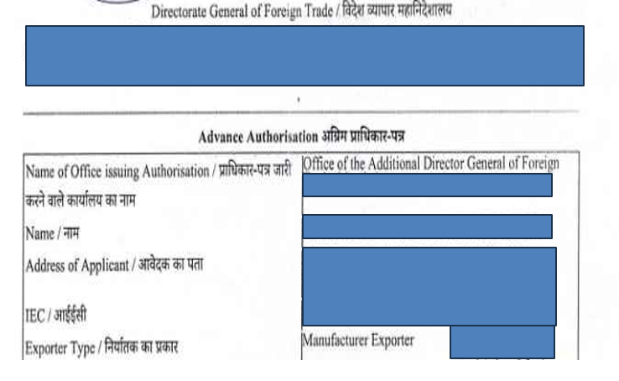
Advance Authorisation…1/2
Advance Authorisation (AA) License: This license, issued by the Directorate General of Foreign Trade (DGFT), allows for duty free import of inputs like gold and silver required for the manufacture of export products.

Slide 23
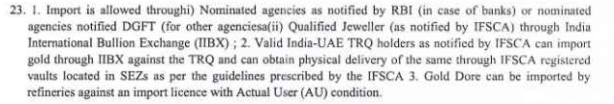
Under the condition sheet of Advance Authorisation Licence at point No. 23 read as follows;
Advance Authorisation…2/2

Slide 24
Advance Authorisation Import Mechanism through IIBX…1/2
Jewellers who hold the Advance Authorisation license and are also IFSCA notified Qualified Jewellers can now leverage the IIBX platform to import Bullion duty free under advance authorization licence. This mechanism streamlines the process and is a major development for India’s Jewellery export sector.
QJ to submit its Advance Authorisation Licence to IIBX
QJ to take AD letter for the quantity wish to trade on IIBX platform
QJ to remit USDs funds
The import is facilitated through the IIBX’s democratic and transparent platform, by purchasing Bullion Depository Receipts (BDRs).

Slide 25
Advance Authorisation Import Mechanism through IIBX…2/2
Post trade QJ to submit BDR extinguishment request to IIDIL (Depository)
QJ to share BDR extinguishment summary, Advance Authorisation Licence to his Customs House Agent (CHA) for BOE filing
QJ to file BOE in the GIFT SEZ customs using its Advance Authorisation License.
Customs clear the shipment under Advance Authorisation License duty free.
QJ to instruct the Vault manager for the delivery in Domestic Tariff Area

Slide 26
BOE filing under Advance Authorisation at Customs
Bond is to be filed with customs, as hitherto.
Once transaction is completed at IIBX & post BDR extinguishment process at IIDI, the Gold can be taken to DTA after the customs clearance process.
Please Note: Under Advance Authorisation for Domestic Tariff Area, the T type BOE is to be filed.

Slide 27
Eligibility Criteria for Silver Importers
Pursuant to the IFSCA Circular dated 2 January 2026, entities with a valid Importer Exporter Code (IEC) are permitted to import silver bars under HS Code 71069221 through IIBX
No requirement to be notified as a Qualified Jeweller (QJ) for imports under HS 71069221
No minimum net worth or turnover criteria required for silver bar imports under this HS code 71069221
This liberalised framework enables broader participation, including traders, refiners, bullion dealers, and industrial users

Slide 28
Opportunity for Silver Importers
Eligible entities may import silver bars (HS 71069221) through standardised IIBX contracts,
Imports are executed on a buy-only basis via Bullion Depository Receipts (BDRs), providing transparency and settlement assurance
Minimum 30 kgs of Silver bars can be imported
Participation is through registered Bullion Trading and Clearing Members of IIBX
Imports are subject to RBI remittance regulations and customs procedures
The framework offers a simple, regulated, and efficient route for silver imports with ongoing oversight by IIBX

Slide 29
Fit & Proper person…1/2
For the purpose of determining as to whether any person is a ‘fit and proper person’, the IFSCA or IIBX may take into account any criteria as it deems fit, including but not limited to the following:
integrity, honesty, ethical behaviour, reputation, fairness and character of the person.
the person not incurring any of the following disqualifications:
an order of conviction has been passed against such person by a court for any economic offence or any offence of the securities law or bullion market;
b. an order of restraint, prohibition or debarment has been passed against such person by the IFSCA or any other regulatory authority or enforcement agency in any matter concerning securities laws or financial markets or bullion market and such order is in force;

Slide 30
Fit & Proper person…2/2
c. recovery proceedings have been initiated by the IFSCA against such person and are pending;
d. an order of conviction has been passed against such person by a court for any offence involving moral turpitude;
e. any winding up proceedings have been initiated or an order for winding up has been passed against such person;
f. such person has been declared insolvent and not discharged;
g. such person has been found to be of unsound mind by a court of competent jurisdiction and the finding is in force;
h. such person has been categorized as a wilful defaulter;
i. such person has been declared a fugitive economic offender;
j. any other disqualification as may be specified by the IFSCA from time to time.
Ref para 7 (j)

Slide 31
Purchase of BDR for import of gold/silver
BDR purchased by Qualified Jeweller in DTA, SEZ Unit exporters, Advance Authorisation holders or valid India-UAE CEPA TRQ holder is extinguished and the Bill of Entry is filed before the expiry of eleven (calendar) day period.
Ref. para 25

Slide 32
HSNs Enabled to Import
Entity type | Prior HSN Codes permitted | New HSN codes permitted
Qualified Jewellers (QJs) | Gold: 71081200 (Other unwrought forms) & 71189000 (Other) Silver: 71069110 (Grains) & 71069290 (Other) | Gold: 71081210 (Other unwrought forms), 71081290 (Other unwrought form: Other) & 71189000 (Other) Silver: 71069120 (Other: Unwrought), 71069221 (Bar) 71069229 (Bar-other)
TRQ holders | 71081200 (Other unwrought forms) | 71081210 (Other unwrought forms)

Slide 33
Import of Gold
through IIBX
by
India UAE CEPA TRQ holders

Slide 34
Prescribed Norms for being a Valid India UAE TRQ holder
Valid holders of India - UAE Tariff Rate Quota (TRQ) license / authorisation as allotted by DGFT are invited to notified as ‘India-UAE TRQ holders’ by the IFSCA, for the purpose of such imports.
Such valid holders of India – UAE TRQ license, need to submit an application to IIBX along with a copy of valid TRQ license as issued by the DGFT along with KYC details. Pre-TRQ onboarding can also be done.
Post internal scrutiny, IIBX will send the application of valid India – UAE TRQ holder to IFSCA for its notification.
After being notified by the IFSCA, such valid India-UAE TRQ holders shall be permitted to participate on IIBX, through Bullion Trading Members, for transacting in (‘buying’ only) UAEGD gold for import under the India-UAE CEPA, subject to the quota.
An entity notified by the IFSCA as a valid India–UAE CEPA TRQ holder shall continue to be recognized as such for subsequent financial year(s), provided it is consistently allotted a TRQ licence in each such year

Slide 35
India UAE CEPA, Tariff Rate Quota (TRQ) and Import Duties
A 10-year Comprehensive Economic Partnership Agreement (CEPA) between the Government of India and the Government of the United Arab Emirates (UAE) was signed on 18 February 2022 and it officially came into force on 1 May 2022.
As per this CEPA, annual Tariff Rate Quota with 1% Customs Duty concession for Gold from UAE under India UAE CEPA.
FY 2025-2026 in first round of allocation for Micro & Small Enterprises total qty for allocation was 30 tonnes (additional 50% in case of more applications).
FY 2026-2027 Bidding is expected to take place in the Month April-May, 2026 for 200 Tonnes of Gold TRQ.
Particulars | No. of bidders | Total Qty received (Tonnes)
Total Bids Received | 512 | 8.59
Technically Qualified Bids | 497 | 8.29
Qty for Next Bidding Round |  | 171.71

Slide 36
Major Advantage for IIBX Buyers (TRQ-Holders: IGCR Removed, Duty credit scrips)
Department of Revenue notification no:66/2023-customs dated on 22nd December 2023 has advised that if Importer and the TRQ holder are same entity then IGCR or specified end user rule will not be applicable.
The TRQ holder when importing through IIBX become direct importer and thus exempted from IGCR rule.
Use of Duty credit scrips (like MEIS, RoDTEP, RoSCTL etc.) is possible in ICEGATE for payment of customs duty post transacting through IIBX.

Slide 37
Gold and Silver Futures
In USD

Slide 38

IIBX Gold/Silver Futures
Margin: Lower margins are required to participate in Gold/Silver futures, The initial margin required to take a position in gold/silver futures is minimum 6%/10% or based on VaR (MPOR Adjusted), whichever is higher.
Global XAU/XAG Pricing: Being traded in US Dollars, the integration of IIBX Gold/Silver Futures price with the Global market price, aligns well with the Global trading market.
Gold/Silver futures flexibility: Overseas entities have the flexibility to trade and do cash settlement as well as do arbitrage on IIBX versus other Global Bullion Exchanges.
Transparent Price Discovery: IIBX provides a platform where transparent pricing is available, offering better price discovery and more competitive pricing compared to the established channels.
Lower Denomination of lot for trade: IIBX facilitates to trade for as low as 1 KG Gold/ 30 KG Silver thereby, enabling enhanced liquidity for all market participants.
IIBX Trading hours : Trading hours on gold/silver futures market are from 09:00 to 23:30 Hrs IST to match trading time with the global markets.

Slide 39
RBI Circular on Hedging at IIBX…1/2
Hedging through Gold Futures: Residents other than individuals having exposure to Price Risk of Gold are allowed to hedge such exposure on IIBX vide RBI Circular No. Ref RBI A.P. (DIR Series) Circular No. 20, dated December 12, 2022 & April, 15, 2024 as amended.
Hedging through Silver Futures: Silver is already permitted under the eligible commodities of this circular. Salient features of the circular;
Banks may permit eligible entities to hedge commodity price risk in the IFSC after satisfying themselves that;
Entity has Price risk either contracted or anticipated
Quantity proposed to be hedged and tenor of the hedge in with the exposure
All payments/receipts related to hedging of exposure to commodity price risk shall be routed through a special account with the bank for this purpose

Slide 40
RBI Circular on Hedging at IIBX…2/2
Hedging is taken up by the management of the entity under a policy approved by the Board of Directors
Entity should have Necessary risk management policies
Entity to take exposure limit from their AD bank, post which banks may remit foreign exchange for hedging transactions
All payments/receipts related to hedging of exposure to commodity price risk shall be routed through a special account with the bank for this purpose
Banks are permitted to issue Standby Letters of Credit (SBLC) / Guarantees, for a maximum period of one year, on behalf of their clients in lieu of making a remittance of margin money for commodity hedging transactions entered by their customers.
Statutory auditors of the entity should give annual certificate on hedging transactions and remittances

Slide 41
Participants in Gold & Silver Futures at IIBX
Refiners
Bullion Dealers
Jewellery Exporters
Domestic Jewellers
Silver Industrial Users
Residents other than individuals having exposure to Price Risk of Gold/Silver

Slide 42
Key Highlights of Gold Futures Contract Specifications at IIBX
Gold Futures Contract Specifications
12 contracts running in a year
1 Kg as Trading Unit
Price Quote in US Dollars per Troy Ounce
Monday to Friday:
09:00 Hrs. to 23:30 Hrs. (IST)
Initial margin 6% on gold (+1 ELM) or based on VaR (MPOR Adjusted), whichever is higher
Delivery Based on intention matching from buyers and sellers

Slide 43
Key Highlights of Silver Futures Contract Specifications at IIBX
Silver Futures Contract Specifications
12 contracts running in a year
30 Kg as Trading Unit
Price Quote in US Dollars per Troy Ounce
Monday to Friday:
09:00 Hrs. to 23:30 Hrs. (IST)
Initial margin 10% on Silver (+1 ELM) or based on VaR (MPOR Adjusted), whichever is higher
Delivery Based on intention matching from buyers and sellers

Slide 44
Approval and Fund Transactions
AD Banks
Domestic Entities
TM/TCM
Provide Hedge facility whereby the quantity which can be hedged is fixed based on assessment of contracted and anticipated exposure of the eligible domestic entities
Open Special Current Account for remittance and flow of Margin in USD
After Special Current Account is opened, they remit the USD to their respective TM/TCM as margin money/Mark-to- Market
The Mark to Market (MTM) settlement is done on the Daily Settlement Price
Mark-to Market(MTM)
Once the member receive the margin from the client the limit is provided for trading on Futures
The MTM Pay-in and Pay-out is collected/ given in US Dollars on T+1 day
Exchange does the MTM settlement in Clearing Members Accounts
Positive MTM is remitted to clients once the requested is placed with the TM/TCM
Negative MTM is paid by the client from the special current account

Slide 45
Gold Futures Contract Specifications Salient Features
Description | Gold Kilo Futures
Underlying Asset | GOLD
Product | GOLD 1 KG
Contract Type | Futures
Concurrent Contracts | Monthly contracts listed for 12 consecutive months.
Trading Session | Monday to Friday: 09:00 Hrs. to 23:30 Hrs. Indian Standard Time (IST).
Trading Unit | 1 Kg
Price Quote | US Dollars per Troy Ounce
Minimum Order Size | 1 Kg
Maximum Order Size | 10 Kg
Tick Size (Minimum Price Movement) | US $ 0.01
Risk Management
1. Initial Margin | Minimum 6% or based on VaR (MPOR Adjusted), whichever is higher.
 | The Exchange Clearing shall calculate the VaR based margins based on Exponential Weighed Moving Average (EWMA) method. The Crystalized MTM losses shall also be blocked from the Member Collateral on real-time basis.
2. Margin Period of Risk | The Margin Period of Risk (MPOR) shall be taken as 3 days. Therefore, the VaR to cover 3 days risk shall be considered i.e., VaR X Sqrt (MPOR Days) where MPOR days would be 3 days.
3. Extreme Loss Margin (ELM) | The Exchange shall impose an Extreme Loss Margin (ELM) of minimum 1% in respect of all outstanding positions.
4.Collaterals | The Exchange Clearing shall accept the following collaterals subject to the minimum ratio of 50:50 between Cash and Non-Cash:
 | 1. Cash – US Dollars
 | 2. Cash Equivalents - Fixed Deposits and Standby Letter of Credit (SBLC) issued by IBUs in IFSC
 | and
 | 3. Non-Cash - Bullion Depository Receipts issued by India International Depository IFSC Ltd. (IIDI), subject to applicable haircuts and daily valuation. (IIBX shall notify separately via circular the date from which BDR shall be acceptable as Collateral.)

Slide 46
Silver Futures Contract Specifications Salient Features
Description | Silver Futures
Underlying Asset | Silver
Product | Silver 30 KG
Contract Type | Futures
Concurrent Contracts | Monthly contracts listed for 12 consecutive months.
Contract Duration | The maximum contract duration for any contract would be 12 months.
Trading Session | Monday to Friday: 09:00 Hrs. to 23:30 Hrs. Indian Standard Time (IST).
Trading Unit | 30 Kg
Price Quote | US Dollars per Troy Ounce
Minimum Order Size | 30 Kg (1 Trading Unit)
Maximum Order Size | 5100 Kg (170 Trading Unit)
Tick Size (Minimum Price Movement) | US $ 0.005
Risk Management
1. Initial Margin | Minimum 10% or based on VaR (MPOR Adjusted), whichever is higher.
 | The Exchange Clearing shall calculate the VaR based margins based on Exponential Weighed Moving Average (EWMA) method. The Crystalized MTM losses shall also be blocked from the Member Collateral on real-time basis.
2. Margin Period of Risk | The Margin Period of Risk (MPOR) shall be taken as 3 days. Therefore, the VaR to cover 3 days risk shall be considered i.e., VaR X Sqrt (MPOR Days) where MPOR days would be 3 days.
3. Extreme Loss Margin (ELM) | The Exchange shall impose an Extreme Loss Margin (ELM) of minimum 1% in respect of all outstanding positions.
4.Collaterals | The Exchange Clearing shall accept the following collaterals subject to the minimum ratio of 50:50 between Cash and Non-Cash :
 | 1. Cash – US Dollars
 | 2. Cash Equivalents - Fixed Deposits and Standby Letter of Credit (SBLC) issued by IBUs in IFSC
 | and
 | 3. c) Non Cash - Bullion Depository Receipts issued by India International Depository IFSC Ltd. (IIDI), subject to applicable haircuts and daily valuation. (IIBX shall notify separately via circular the date from which BDR shall be acceptable as Collateral.)

Slide 47

IIBX Annual Plan for FY 2025-26
May 2025
FY 2025-26
FY 2025-26
FY 2025-26
MEPZ Vault at Chennai (Done)
Gold for Advance Authorisation Licence holders (Done)
Supply to SEZ Exporters
Introduction of Loco swap & delivery at Singapore & Dubai of FBDR
May 2025
Q2 FY 2025-26
FY 2025-26
FY 2025-26
Extension in Trading Hours for T+0 contracts by 3 hours till 9:30 pm (Done)
Activation of Futures (Done)
Launch of 9999 Purity, 1 kg & 12.5 kgs Contract (Done)
Launch of T+2+D & T10 products

Slide 48
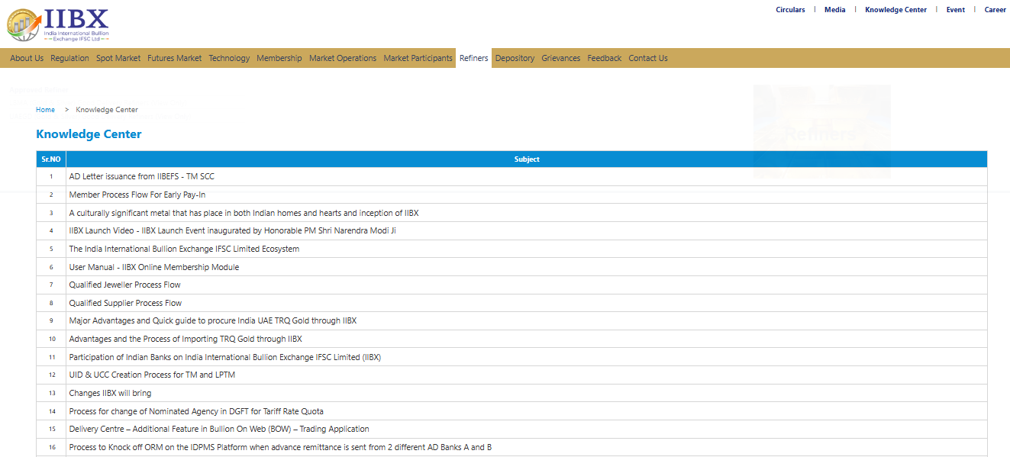
Knowledge center at IIBX website
IIBX's website now includes a knowledge center aimed at educating and spreading awareness about IIBX services

Slide 49

Thank You
https://www.iibx.co.in

