Slide 1


Presentation on
Import of Bullion by Exporters through IIBX
under Advance Authorisation Licence
&
Understanding IFSCA Circular on revised Qualifying criteria for Qualified Jewellers

Slide 2


India’s first International Financial Services Center (IFSC) is set up under Special Economic Zone Act, 2005 (“SEZ Act 2005”)
Government of India operationalized International Financial Services Center (IFSC) at GIFT Multi Services SEZ in April 2015
GIFT is conceptualized as a global Financial and IT Services hub, a first of its kind in India, designed to be at or above par with globally benchmarked financial centers

Slide 3

International Financial Services Centres Authority
Role of IFSCA
The IFSCA is a unified authority for the development and regulation of financial products, financial services and financial institutions in the International Financial Services Centres (IFSC) in India. The IFSCA has been established as a unified regulator under the International Financial Services Centre Authority Act passed by the Indian Parliament in 2019 with a holistic vision in order to promote ease of doing business in IFSC and provide world class regulatory environment.
Purpose of IFSCA
The main objective of the IFSCA is to develop a strong global connect and focus on the needs of the Indian economy as well as to serve as an international financial platform for the entire region and the global economy as a whole.
Prior to the establishment of IFSCA, the domestic financial regulators, namely, RBI, SEBI, PFRDA and IRDAI regulated the business in IFSC.

Slide 4








Promoters of India International Bullion Exchange IFSC Ltd.
Promoted by the following MIIs through India International Bullion Holding IFSC Ltd. (IIBH)
20%
20%
10%
20%
10%
20%
Shareholding pattern in India International Bullion Holding IFSC Ltd. is shown above.

Slide 5






Evolution of IIBX
DECEMBER 2020
July 29, 2022
March 06, 2024
IFSCA notifies International Financial Services Centres Authority (Bullion Exchange) Regulations, 2020
Hon’ble Prime Minister of India launched IIBX
State Bank of India become the first bank as TCM of IIBX
FEBRUARY 2020
DECEMBER 2021
May 10, 2023
Feb 28, 2025
Finance Minister announced to set up an International Bullion Exchange at GIFT IFSC
License Issue Date
Integration with ICEGATE the Customs Portal
HDFC Bank became the first bank to import Gold under SCC-Nominated Bank route

Slide 6


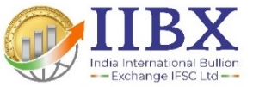
IIBX Ecosystem
Qualified Jewellers & TRQ Holders
Qualified Suppliers
International Bullion Banks,
Refineries and Bullion Traders
being onboarded
Qualified Jewellers can
import Gold and Silver & valid TRQ holders can import Gold
Unified Regulator
Clients from DTA /India can hedge the Gold Price risk
DTA Clients
World class Vaulting facilities with 3 vaults in GIFT City , One at Chennai
Vaults
SCC
India International Depository IFSC Ltd.(IIDI)
maintaining Demat Accounts
Nominated Banks Authorized to import Gold and Silver in India as Special Category Client
IIDI
Trading Members
International
Clients
International Clients can hedge the Gold Price risk
IFSC Banking Units are also permitted to act as TM/CM

Slide 7


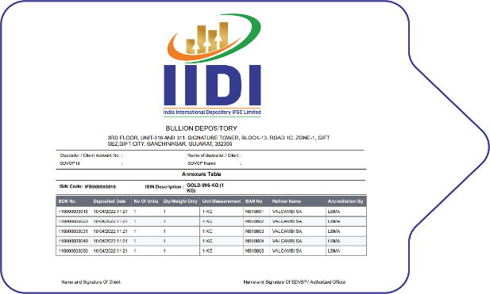
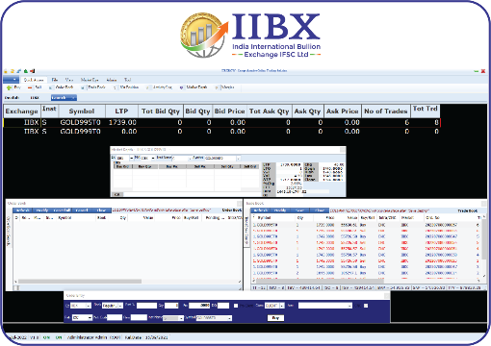
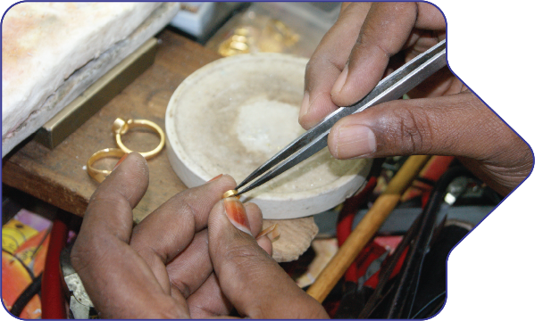
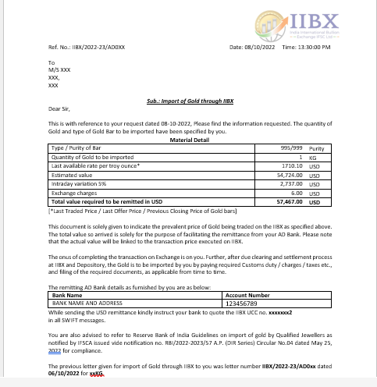

Process Flow..1
Sellers
Bullion Dealers/Banks
Deposit Bullion at IFSC Vaults and Demat process
Generation of Bullion Depository Receipt (BDR)
Place Sell Order on IIBX Trading System
Buyers
Qualified Jewellers
AD letter by IIBX for USD remittance by QJ
INR to USD and receipt of USD in IIBX Clearing
Place Buy Order on IIBX Trading System

Slide 8
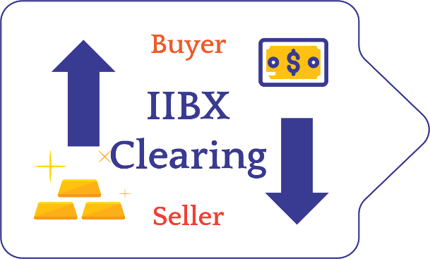

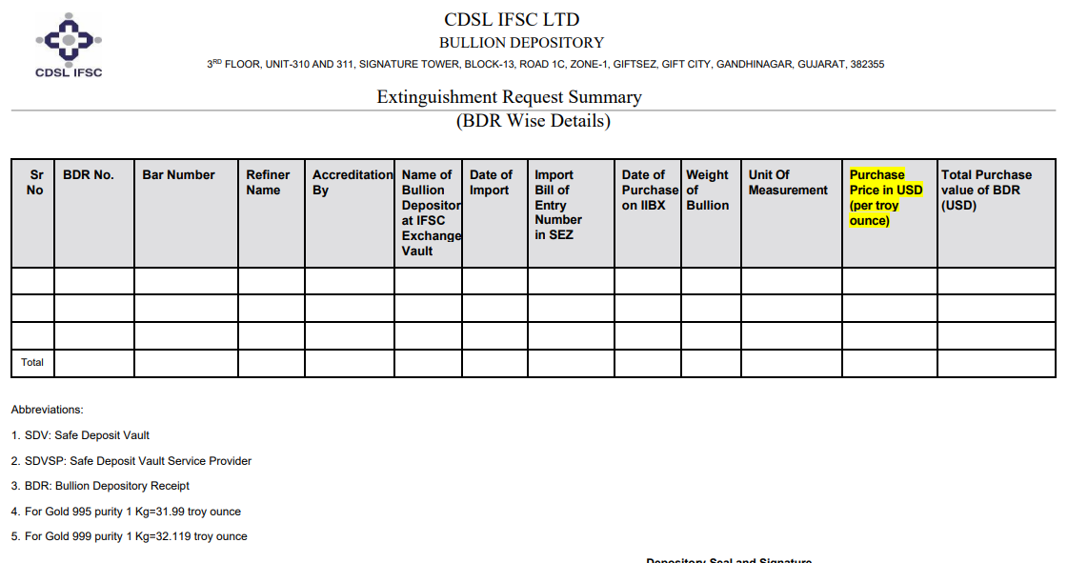
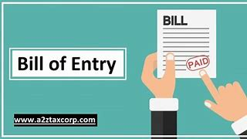



Process Flow..2
Buy and Sell Order Matches
IIBX - Clearing
Transfer of BDR to Buyer Demat Account by IIDI
Extinguishment of Bullion Depository Receipts
Filing of Bill of Entry
Customs Clearance
Remat of BDR into Physical Gold at Vault
Door Delivery across India within 24 Hours

Slide 9

Existing T+0 Products, Market Hours and Settlement Type
Products live at IIBX – GIFT City & Chennai Contracts
LBMA Good Delivery Bars
UAE Good Delivery Bars
LBMA / UAE Good Delivery Bars
GOLD MINI 100 GRAMS
GOLD 1 KG
GOLD MINI
100 GRAMS
GOLD 1KG
Silver Grains
(20 Kg)
Silver Bars (30Kg)
UAEGD GOLD 995 T+0
UAEGD GOLD 999 100 Grams T+0
UAEGDTRQ GOLD 995 T+0
UAEGDTRQ GOLD 999 100 Grams T+0
SILVER GRAINS T+0 ( LBMA )
UAEGD SILVER GRAINS T+0
*UAEGDCEPA SILVER GRAINS T+0 *Only at GIFT ciTY
GOLD 995 T+0
GOLD MINI 999 T+0
SILVER BARS T+0 ( LBMA )
UAEGD SILVER BARS T+0
Market Hours
9:00 Hrs. to 21:30 Hrs. (IST)
T+0 Settlement Contracts
100% Early Pay-in of Funds & Securities
Delivery - Compulsory in Bullion Depository Receipts
Delivery Center – Gift City & Chennai Vaults
BDR Settlement
at Every 30 Minutes
Fund Settlement
at 12:15 ,15:15, 18:45 & 21:30 (IST)

Slide 10
Global First Initiatives
One to one congruence between BDR and physical Bar/Grain bag.
IIBX is first Exchange globally to introduce ‘Every 30 minutes Settlement of BDRs’
Direct Pay-out to Buyers have been introduced wherein the BDRs are directly credited to the Buyer’s Demat account without the intervention of the intermediate Clearing and Trading Members.
Fund settlement cycle is now activated 4 times at every at 12:15 ,15:15, 18:45 & 21:30 .
Multiple Fund settlement Cycles reduces TAT of overall trade process, encouraging Qualified Suppliers to offer best rates and manage Bullion shipment cycles and Cash flow of funds more efficiently.
These innovative solutions have paved the way for same day delivery of Bullion through IIBX ecosystem for the Qualified Jewellers.

Slide 11
Major Advantage for IIBX Buyers (TRQ-Holders: IGCR Removed, Duty credit scrips)
Department of Revenue notification no:66/2023-customs dated on 22nd December 2023 has advised that if Importer and the TRQ holder are same entity then IGCR or specified end user rule will not be applicable.
The TRQ holder when importing through IIBX become direct importer and thus exempted from IGCR rule.
Use of Duty credit scrips (like MEIS, RoDTEP, RoSCTL etc.) is possible in ICEGATE for payment of customs duty post transacting through IIBX.

Slide 12
Import of Bullion by Exporters through IIBX under Advance Authorisation Scheme
Pre Conditions
Valid Advance Authorisation Licence issued by DGFT
Should be a Qualified Jeweller of IIBX

Slide 13
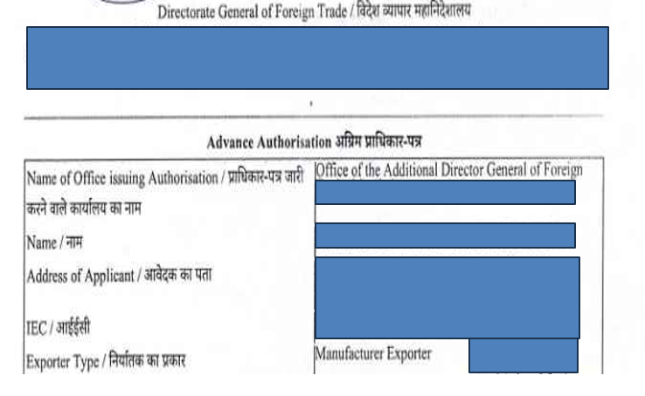
Advance Authorisation…1/2
Advance Authorisation (AA) License: This license, issued by the Directorate General of Foreign Trade (DGFT), allows for duty free import of inputs like gold and silver required for the manufacture of export products.

Slide 14
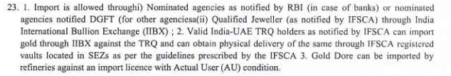
Under the condition sheet of Advance Authorisation Licence at point No. 23 read as follows;
Advance Authorisation…2/2

Slide 15
Advance Authorisation Import Mechanism through IIBX…1/2
Jewellers who hold the Advance Authorisation license and are also IFSCA notified Qualified Jewellers can now leverage the IIBX platform to import Bullion duty free under advance authorization licence. This mechanism streamlines the process and is a major development for India’s Jewellery export sector.
QJ to submit its Advance Authorisation Licence to IIBX
QJ to take AD letter for the quantity wish to trade on IIBX platform
QJ to remit USDs funds
The import is facilitated through the IIBX’s democratic and transparent platform, by purchasing Bullion Depository Receipts (BDRs).

Slide 16
Advance Authorisation Import Mechanism through IIBX…2/2
Post trade QJ to submit BDR extinguishment request to IIDIL (Depository)
QJ to share BDR extinguishment summary, Advance Authorisation Licence to his Customs House Agent (CHA) for BOE filing
QJ to file BOE in the GIFT SEZ customs using its Advance Authorisation License.
Customs clear the shipment under Advance Authorisation License duty free.
QJ to instruct the Vault manager for the delivery in Domestic Tariff Area

Slide 17
BOE filing under Advance Authorisation at Customs
Bond is to be filed with customs, as hitherto.
Once transaction is completed at IIBX & post BDR extinguishment process at IIDI, the Gold can be taken to DTA after the customs clearance process.
Please Note: Under Advance Authorisation for Domestic Tariff Area, the T type BOE is to be filed.

Slide 18
Gold for SEZ Exporters of Jewellery
Gold for Exporters of Jewellery in SEZs
Development Commissioner of GIFT SEZ has issued a public notice on 06/2023-24 whereby Standard Operating Procedure (SOP) has been issued in accordance with Rule 38 of SEZ rules, 2006, Which address the need for Zone to Zone transfer of bullion imported by Qualified Jewellers through IIBX.
The SEZ Division of the Department of Commerce, Ministry of Commerce & Industry, Government of India, has issued letter No.J.16/3/2007-SEZ Vol-V, dated June 22, 2024, to all Development Commissioners of Special Economic Zones regarding the implementation of ICEGATE at all SEZs, except IT/ITES SEZs and FTWZs, effective from July 1, 2024.

Slide 19
UNDERSTANDING IFSCA CIRCULAR ON REVISED QUALIFYING CRITERIA FOR QUALIFIED JEWELLERS
IFSCA-PMTS/10/2023-Precious Metals
dated October 10, 2025

Slide 20
Revised Norms for being a Qualified Jeweller (QJ)…1/2
The entity shall be engaged in the business of goods falling under ITS(HS) codes 7106, 7108, 7113, 7114 and 7118 under Chapter 71 of ITC(HS);
b) The entity must have filed due GST returns up to the preceding month/quarter, as applicable, prior to making an application to the IIBX;
c) A certificate should be submitted by the entity, duly attested by a practicing chartered accountant or a practicing cost accountant or a practicing company secretary, stating that:
i. 60% of annual turnover in each of the last 3 financial years including the current financial year until the date of making the application, or

Slide 21
Revised Norms for being a Qualified Jeweller (QJ)…2/2
ii. 90% of annual turnover in the previous entire financial year including the current financial year until the date of making the application.
are through dealing in goods falling under ITS(HS) codes 7106, 7108, 7113, 7114 and 7118 under Chapter 71 of ITC(HS); and
d) The entity shall have a minimum net worth of INR 15 crore as per its latest audited financial statement.
e) An applicant shall be considered for notification as a Qualified Jeweller only if it
qualifies as a “fit and proper person”.
Ref. Para 3

Slide 22
Fit & Proper person…1/2
For the purpose of determining as to whether any person is a ‘fit and proper person’, the IFSCA or IIBX may take into account any criteria as it deems fit, including but not limited to the following:
integrity, honesty, ethical behaviour, reputation, fairness and character of the person.
ii. the person not incurring any of the following disqualifications:
an order of conviction has been passed against such person by a court for any economic offence or any offence of the securities law or bullion market;
b. an order of restraint, prohibition or debarment has been passed against such person by the IFSCA or any other regulatory authority or enforcement agency in any matter concerning securities laws or financial markets or bullion market and such order is in force;

Slide 23
Fit & Proper person…2/2
c. recovery proceedings have been initiated by the IFSCA against such person and are pending;
d. an order of conviction has been passed against such person by a court for any offence involving moral turpitude;
e. any winding up proceedings have been initiated or an order for winding up has been passed against such person;
f. such person has been declared insolvent and not discharged;
g. such person has been found to be of unsound mind by a court of competent jurisdiction and the finding is in force; h. such person has been categorized as a wilful defaulter;
i. such person has been declared a fugitive economic offender;
j. any other disqualification as may be specified by the IFSCA from time to time.
Ref para 7 (j)

Slide 24
Revised Norms for being a Valid India UAE TRQ holder
IFSCA’s notification of an entity as a valid India-UAE CEPA TRQ holder shall remain valid for the subsequent financial year(s) as well, subject to the following conditions:
a) it has been allotted TRQ license/authorization by the DGFT for that financial year, and
b) it has been continually allotted TRQ license/authorization (i.e. every year or as per any other frequency at which DGFT may issue TRQ license/authorization) by the DGFT since it was originally notified by the IFSCA as a valid India-UAE CEPA TRQ holder.
c) already notified valid India-UAE CEPA TRQ holder submits to IIBX a copy of the newly issued TRQ license/authorization as issued by DGFT
Ref. Para 13

Slide 25
Purchase of BDR for import of gold/silver
BDR purchased by Qualified Jeweller or valid India-UAE CEPA TRQ holder is extinguished and the Bill of Entry is filed before the expiry of eleven (calendar) day period.
Ref. para 25

Slide 26
HSNs Enabled to Import
Entity type | Prior HSN Codes permitted | New HSN codes permitted
Qualified Jewellers (QJs) | Gold: 71081200 (Other unwrought forms) & 71189000 (Other) Silver: 71069110 (Grains) & 71069290 (Other) | Gold: 71081210 (Other unwrought forms), 71081290 (Other unwrought form: Other) & 71189000 (Other) Silver: 71069120 (Other: Unwrought), 71069221 (Bar) 71069229 (Bar-other)
TRQ holders | 71081200 (Other unwrought forms) | 71081210 (Other unwrought forms)

Slide 27

IIBX Annual Plan for FY 2025-26
May 2025
FY 2025-26
FY 2025-26
FY 2025-26
MEPZ Vault at Chennai (Done)
Gold for Advance Authorisation Licence holders (Done)
Gold for Exporters in SEZ
Introduction of Loco swap & delivery at Singapore & Dubai of FBDR
May 2025
Q2 FY 2025-26
FY 2025-26
FY 2025-26
Extension in Trading Hours for T+0 contracts by 3 hours till 9:30 pm (Done)
Activation of Futures (Done)
Launch of T+2+D & T10 products
Launch of Digital Gold investment products

Slide 28
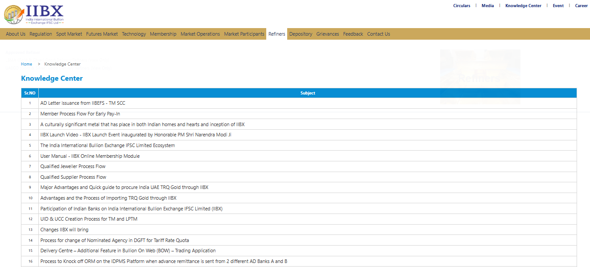
Knowledge center at IIBX website
IIBX's website now includes a knowledge center aimed at educating and spreading awareness about IIBX services

Slide 29

Thank You
https://www.iibx.co.in

