Slide 1

INDIA INTERNATIONAL BULLION EXCHANGE IFSC LTD.
Presentation
for
Webinar on TRQ Application Fees Refund Process

Slide 2








Promoters of India International Bullion Exchange IFSC Ltd.
Promoted by the following MIIs through India International Bullion Holding IFSC Ltd. (IIBH)
20%
20%
10%
20%
10%
20%
Shareholding pattern in India International Bullion Holding IFSC Ltd. is shown above.

Slide 3




IIBX Ecosystem
Qualified Jewellers & TRQ Holders
Qualified Suppliers
International Bullion Banks,
Refineries and Bullion Traders
being onboarded
Qualified Jewellers can
import Gold and Silver & valid TRQ holders can import Gold
Unified Regulator
Clients from DTA /India can hedge the Gold Price risk
DTA Clients
World class Vaulting facilities with 3 vaults in GIFT City , One at Chennai
Vaults
SCC
India International Depository IFSC Ltd.(IIDI)
maintaining Demat Accounts
Nominated Banks Authorized to import Gold and Silver in India as Special Category Client
IIDI
Trading Members
International
Clients
International Clients can hedge the Gold Price risk
IFSC Banking Units are also permitted to act as TM/CM

Slide 4


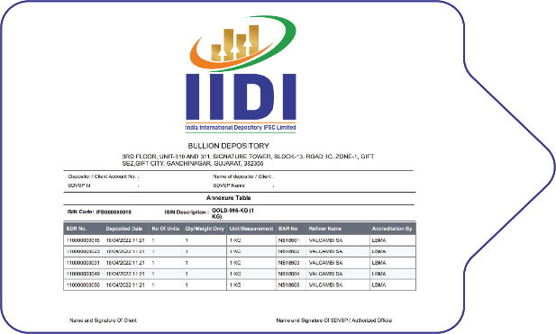
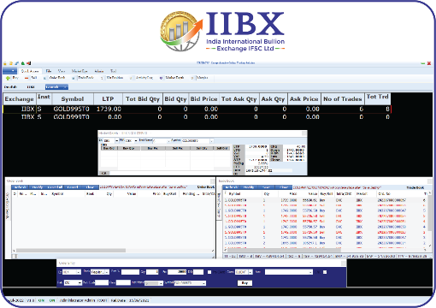
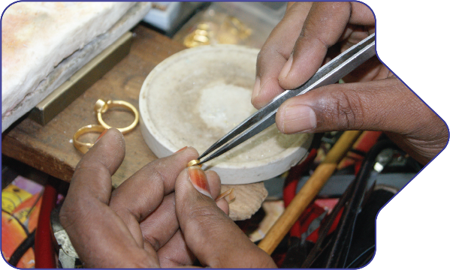
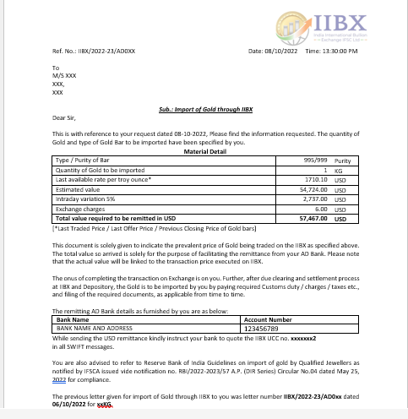

Process Flow..1
Sellers
Bullion Dealers/Banks
Deposit Bullion at IFSC Vaults and Demat process
Generation of Bullion Depository Receipt (BDR)
Place Sell Order on IIBX Trading System
Buyers
Qualified Jewellers
AD letter by IIBX for USD remittance by QJ
INR to USD and receipt of USD in IIBX Clearing
Place Buy Order on IIBX Trading System

Slide 5
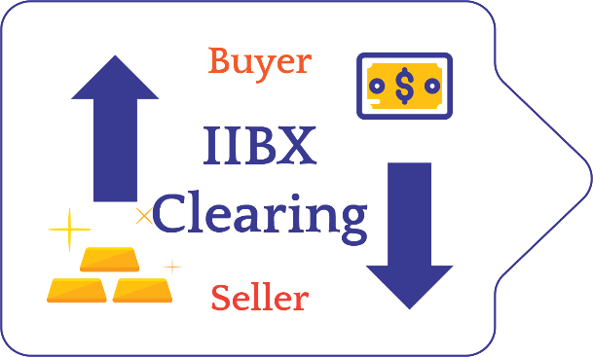

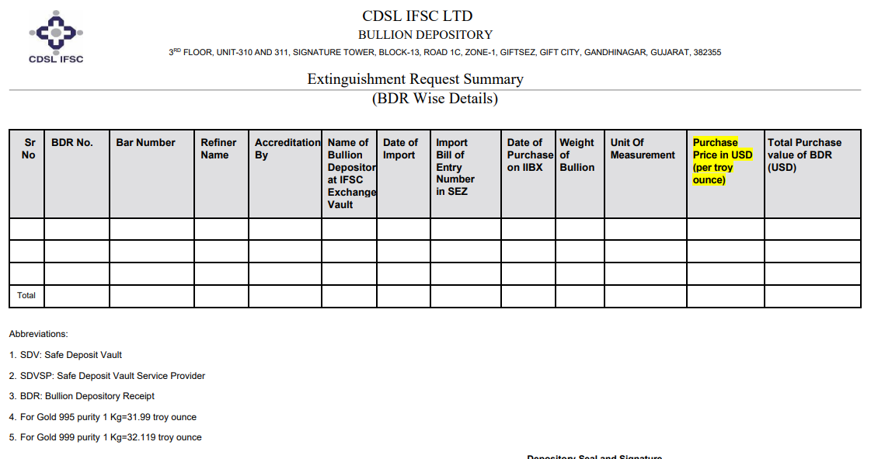




Process Flow..2
Buy and Sell Order Matches
IIBX - Clearing
Transfer of BDR to Buyer Demat Account by IIDI
Extinguishment of Bullion Depository Receipts
Filing of Bill of Entry
Customs Clearance
Remat of BDR into Physical Gold at Vault
Door Delivery across India within 24 Hours

Slide 6
Reserve Bank of India : Circulars related to IIBX
Enabling US Dollar flows for import of gold through IIBX by Qualified Jewellers - 25th May 2022
Instructions issued for the Branches of Indian Banks operating in GIFT IFSC to act as Professional Clearing Member (PCM) - 7th June 2022
Eligible entities having direct exposure to Gold price risk allowed to hedge their positions at IFSC Exchanges - 12th December 2022
RBI on 07th June 2022, has issued circular no. RBI/2022-23/62 allowing branches of Indian banks operating in GIFT-IFSC to act as Professional Clearing Member (PCM) of India International Bullion Exchange IFSC Limited (IIBX). ICICI Bank and SBI is already onboarded as PCM of IIBX.
RBI on 09th February 2024, has issued circular no. RBI/2023-24/120 allowing Participation of Indian Banks on IIBX as;
a Branch/subsidiary/joint venture of an Indian bank in GIFT-IFSC to act as a Trading Member (TM)/Trading and Clearing Member (TCM) of IIBX. IIBX is in receipt of applications from IBUs to get onboard as TM/TCM.
Indian banks authorized to import gold/silver to act as a Special Category Client (SCC) of IIBX. IIBX is in receipt to few inquiries from nominated banks to get onboard as SCC.

Slide 7

Existing T+0 Products, Market Hours and Settlement Type
Products live at IIBX – GIFT City & Chennai Contracts
LBMA Good Delivery Bars
UAE Good Delivery Bars
LBMA / UAE Good Delivery Bars
GOLD MINI 100 GRAMS
GOLD 1 KG
GOLD MINI
100 GRAMS
GOLD 1KG
Silver Grains
(20 Kg)
Silver Bars (30Kg)
UAEGD GOLD 995 T+0
UAEGD GOLD 999 100 Grams T+0
UAEGDTRQ GOLD 995 T+0
UAEGDTRQ GOLD 999 100 Grams T+0
SILVER GRAINS T+0 ( LBMA )
UAEGD SILVER GRAINS T+0
*UAEGDCEPA SILVER GRAINS T+0 *Only at GIFT GITY
GOLD 995 T+0
GOLD MINI 999 T+0
SILVER BARS T+0 ( LBMA )
UAEGD SILVER BARS T+0
Market Hours
9:00 Hrs. to 21:30 Hrs. (IST)
T+0 Settlement Contracts
100% Early Pay-in of Funds & Securities
Delivery - Compulsory in Bullion Depository Receipts
Delivery Center – Gift City & Chennai Vaults
BDR Settlement
at Every 30 Minutes
Fund Settlement
at 12:15 ,15:15, 18:45 & 21:30 (IST)

Slide 8
Major Advantage for IIBX Buyers (TRQ-Holders: IGCR Removed, Duty credit scrips)
Department of Revenue notification no:66/2023-customs dated on 22nd December 2023 has advised that if Importer and the TRQ holder are same entity then IGCR or specified end user rule will not be applicable.
The TRQ holder when importing through IIBX become direct importer and thus exempted from IGCR rule.
Use of Duty credit scrips (like MEIS, RoDTEP, RoSCTL etc.) is possible in ICEGATE for payment of customs duty post transacting through IIBX.

Slide 9
Revised Norms for being a Qualified Jeweller (QJ)…1/2
The entity shall be engaged in the business of goods falling under ITS(HS) codes 7106, 7108, 7113, 7114 and 7118 under Chapter 71 of ITC(HS);
b) The entity must have filed due GST returns up to the preceding month/quarter, as applicable, prior to making an application to the IIBX;
c) A certificate should be submitted by the entity, duly attested by a practicing chartered accountant or a practicing cost accountant or a practicing company secretary, stating that:
i. 60% of annual turnover in each of the last 3 financial years including the current financial year until the date of making the application, or

Slide 10
Revised Norms for being a Qualified Jeweller (QJ)…2/2
ii. 90% of annual turnover in the previous entire financial year including the current financial year until the date of making the application.
are through dealing in goods falling under ITS(HS) codes 7106, 7108, 7113, 7114 and 7118 under Chapter 71 of ITC(HS); and
d) The entity shall have a minimum net worth of INR 15 crore as per its latest audited financial statement.
e) An applicant shall be considered for notification as a Qualified Jeweller only if it
qualifies as a “fit and proper person”.
Ref. Para 3

Slide 11
Fit & Proper person…1/2
For the purpose of determining as to whether any person is a ‘fit and proper person’, the IFSCA or IIBX may take into account any criteria as it deems fit, including but not limited to the following:
integrity, honesty, ethical behaviour, reputation, fairness and character of the person.
ii. the person not incurring any of the following disqualifications:
an order of conviction has been passed against such person by a court for any economic offence or any offence of the securities law or bullion market;
b. an order of restraint, prohibition or debarment has been passed against such person by the IFSCA or any other regulatory authority or enforcement agency in any matter concerning securities laws or financial markets or bullion market and such order is in force;

Slide 12
Fit & Proper person…2/2
c. recovery proceedings have been initiated by the IFSCA against such person and are pending;
d. an order of conviction has been passed against such person by a court for any offence involving moral turpitude;
e. any winding up proceedings have been initiated or an order for winding up has been passed against such person;
f. such person has been declared insolvent and not discharged;
g. such person has been found to be of unsound mind by a court of competent jurisdiction and the finding is in force; h. such person has been categorized as a wilful defaulter;
i. such person has been declared a fugitive economic offender;
j. any other disqualification as may be specified by the IFSCA from time to time.
Ref para 7 (j)

Slide 13
Purchase of BDR for import of gold/silver
BDR purchased by Qualified Jeweller or valid India-UAE CEPA TRQ holder is extinguished and the Bill of Entry is filed before the expiry of eleven (calendar) day period.
Ref. para 25

Slide 14
TRQ Application Fees Refund Process
at
DGFT

Slide 15
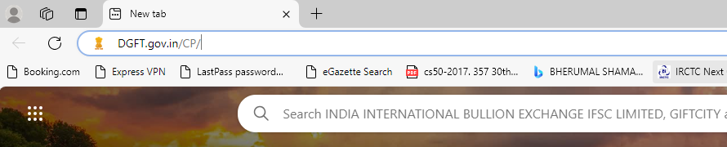
Type DGFT.gov.in

Slide 16
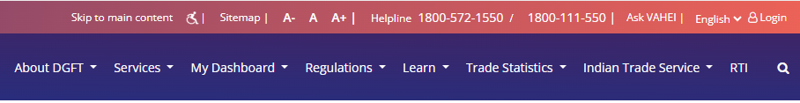
Click on Login

Slide 17
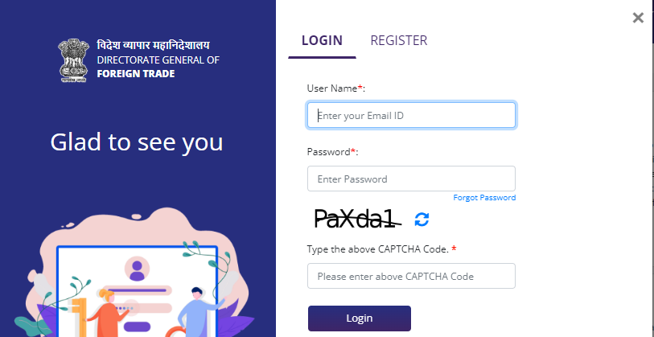
Enter your
registered email ID
Enter your password
Enter Captcha

Slide 18
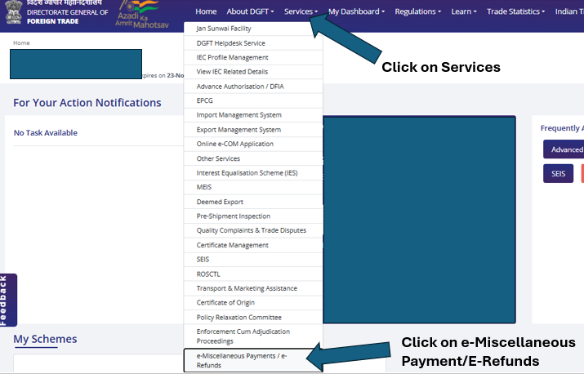

Slide 19
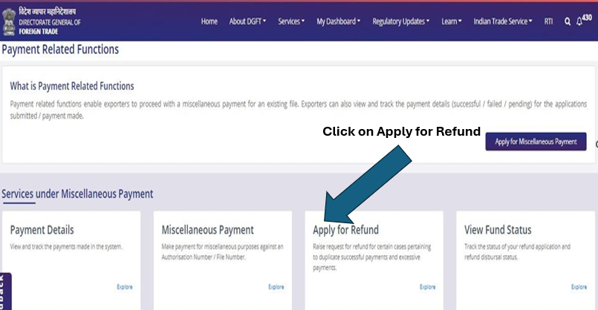

Slide 20
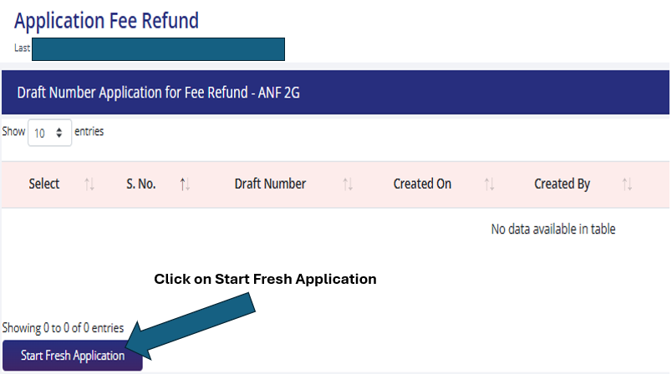

Slide 21
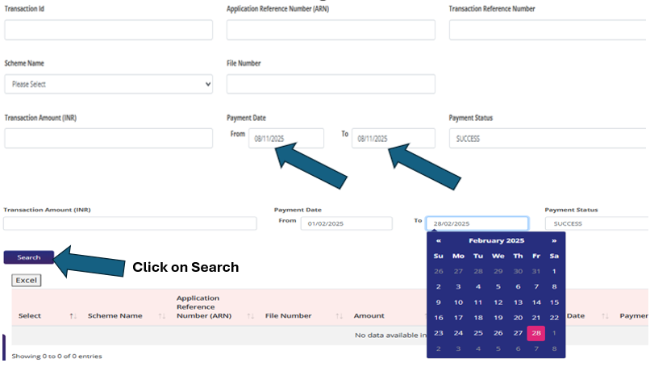

Slide 22
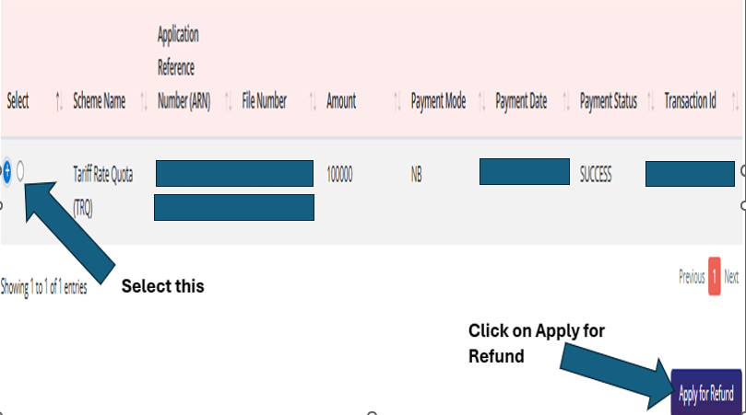

Slide 23
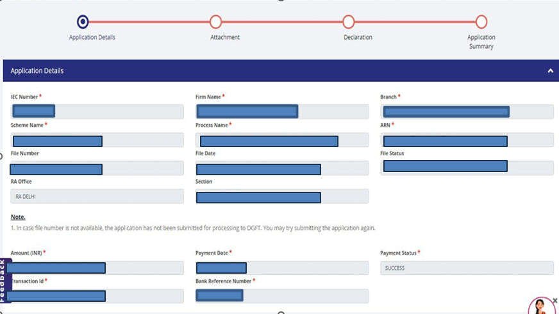

Slide 24
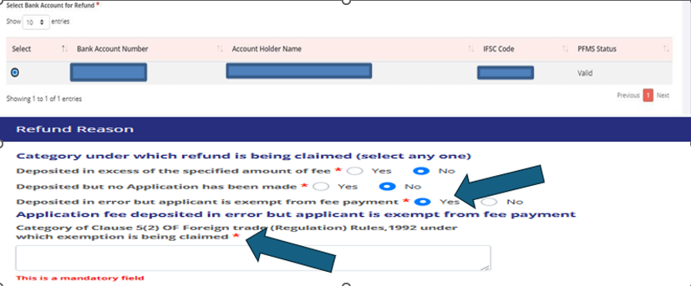
*In the Comment Box write: Trade Notice No 16 of 2025 & 2026 dt 29 Oct 2025
Please select Category 3

Slide 25
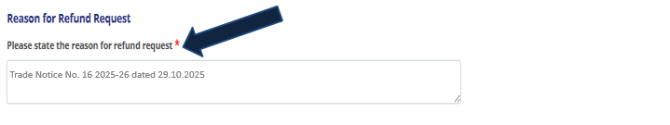
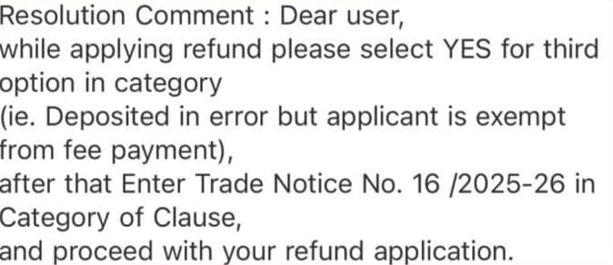

Slide 26
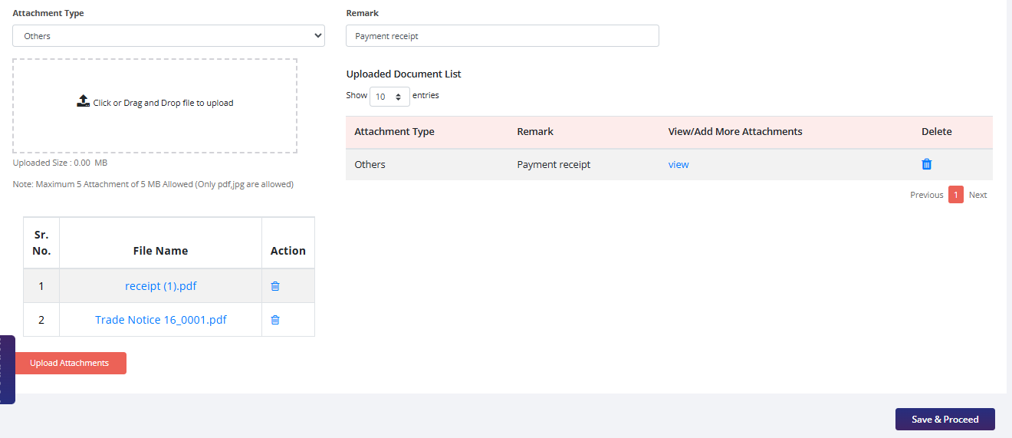
Click on Save & Proceed

Slide 27
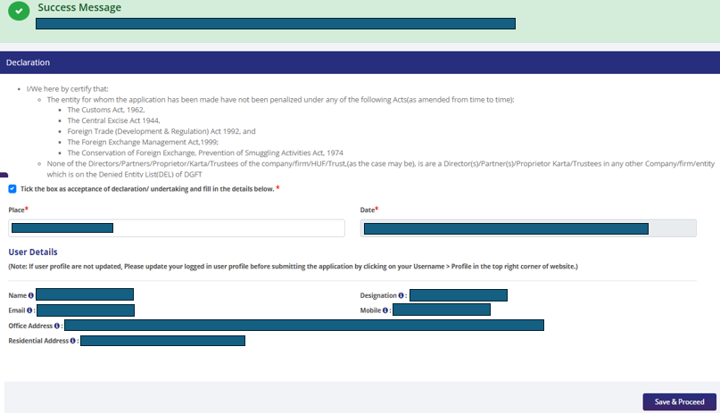
Click on Save & Proceed

Slide 28
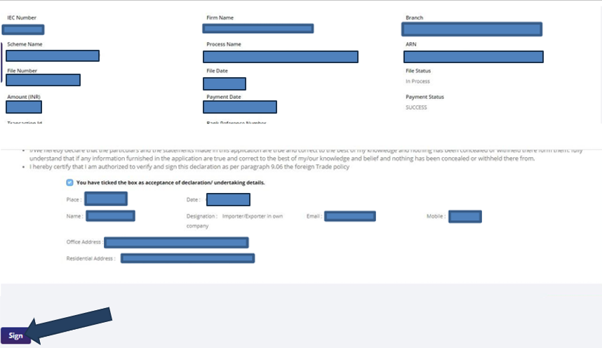
Sign either through Aadhar or Digital Signature Certificate (DSC)

Slide 29
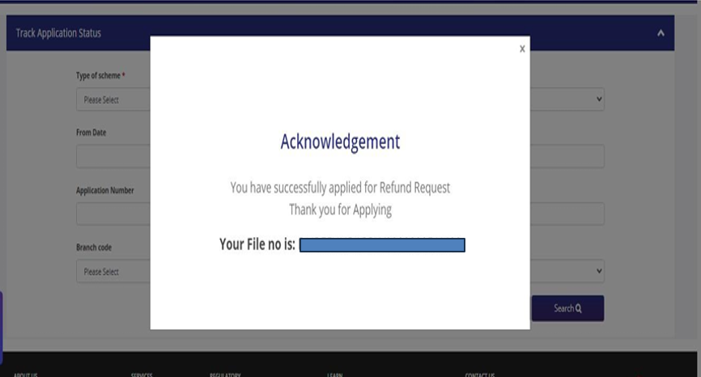

Slide 30
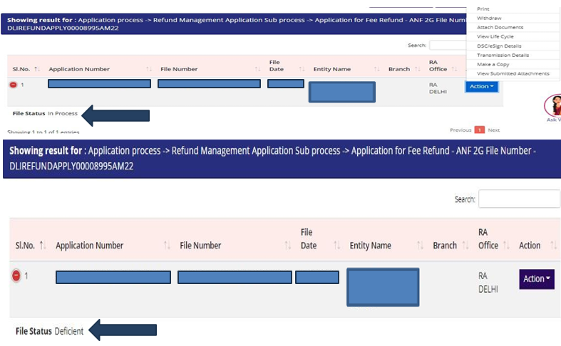
File Status in Process
File Status Deficient

Slide 31
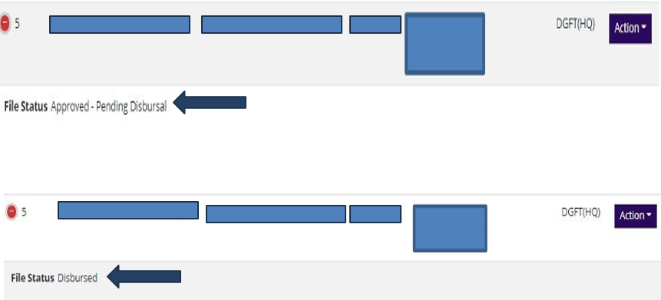
File Status Approved- Pending Disbursal
File Status Disbursed

Slide 32
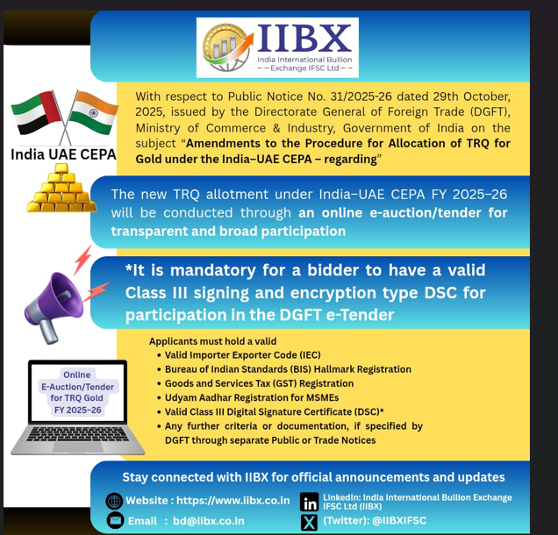

Slide 33
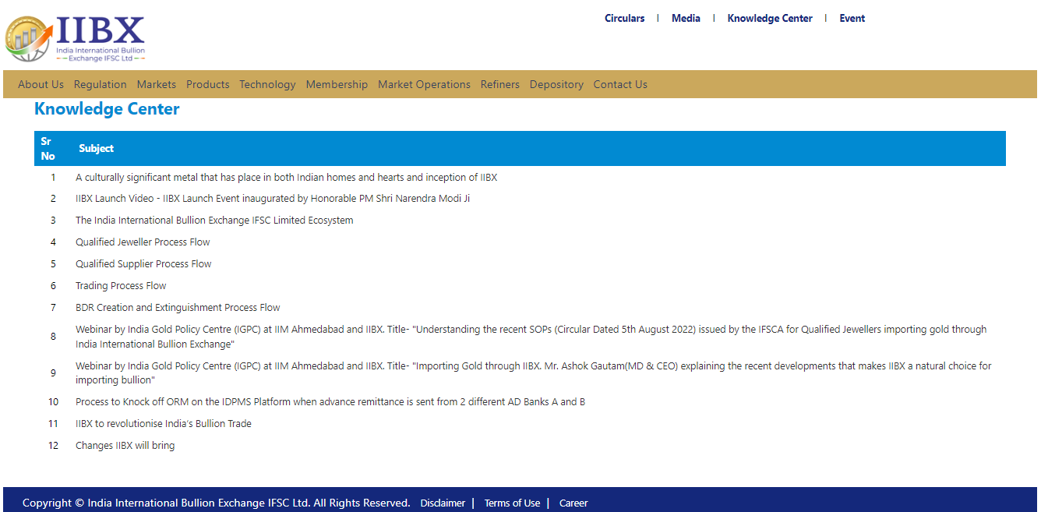
Knowledge center at IIBX website
IIBX's website now includes a knowledge center aimed at educating and spreading awareness about IIBX services

Slide 34

https://www.iibx.co.in

